Slide 1
Day 5

Slide 2
Day | Topic | Chapter Details | Time Duration
Day 5 | Set theory and sub query | Set theory for SQL Joins | 60 mins
 |  | UNION vs. UNION ALL
 |  | Comparing two set operations
 |  | INTERSECT
 |  | Review UNION and INTERSECT
 |  | EXCEPT
 |  | Subquerying with semi joins and anti joins
 |  | Multiple WHERE clauses
 |  | Semi join
 |  | Diagnosing problems using anti join
 | 5 mins Break
 | Sub Query part II | Subqueries inside WHERE and SELECT | 60 mins
 |  | Subquery inside WHERE
 |  | Subquery inside SELECT
 |  | Subqueries inside FROM
 |  | Subquery inside FROM

Slide 3

Time For Revision

Slide 4
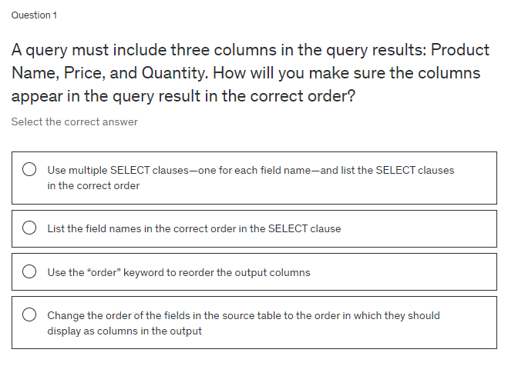

Slide 5
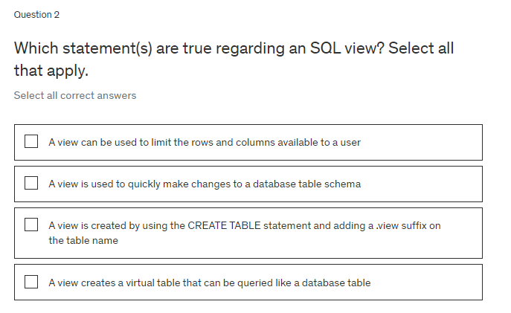

Slide 6
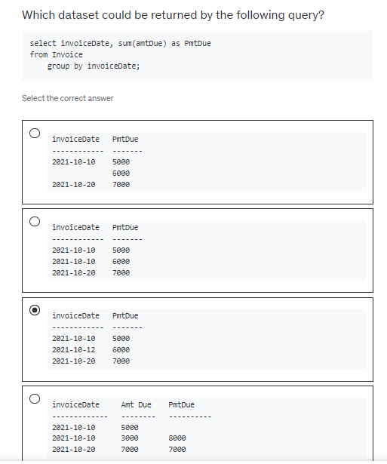

Slide 7
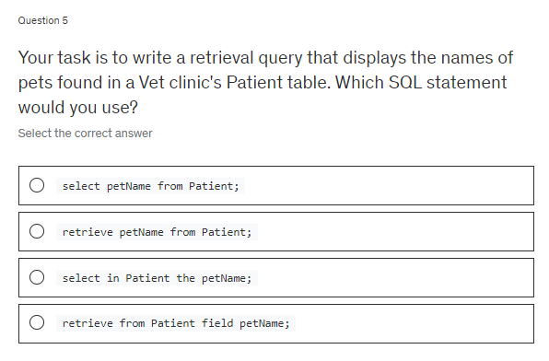

Slide 8
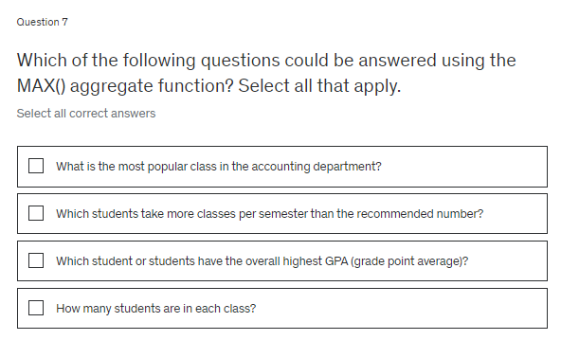

Slide 9
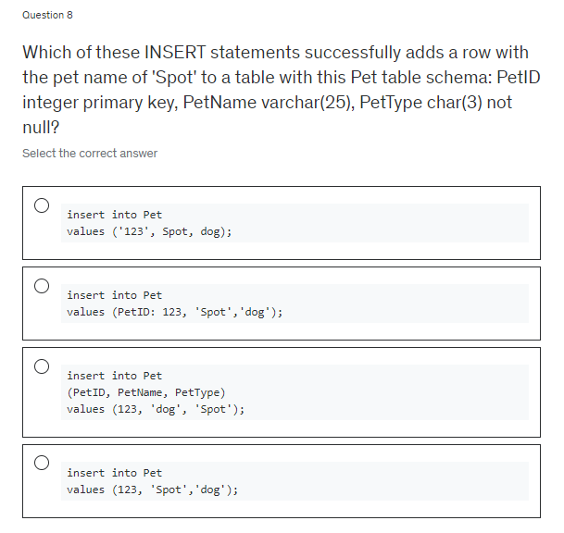

Slide 10
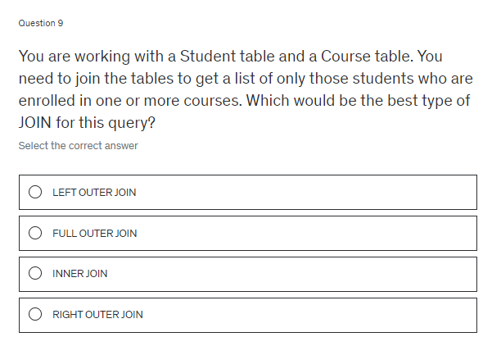

Slide 11
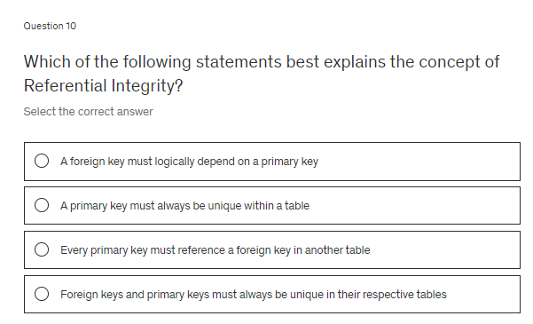

Slide 12
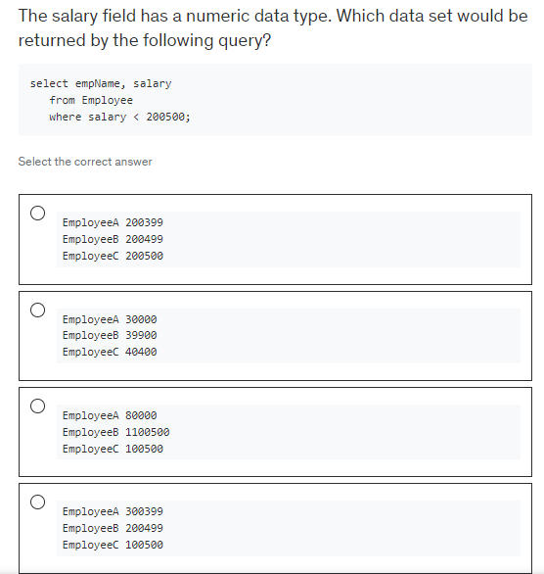

Slide 13
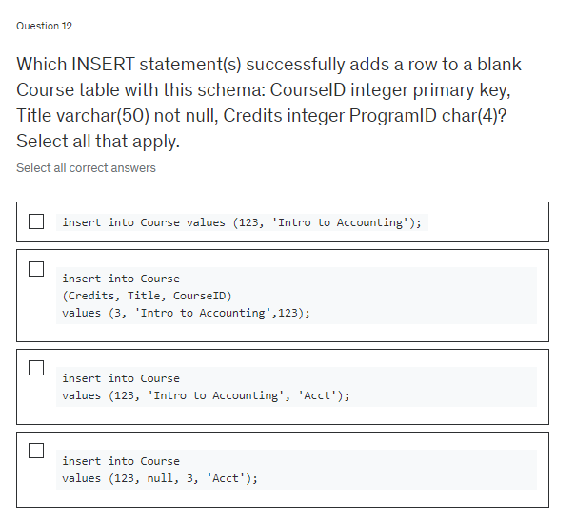

Slide 14
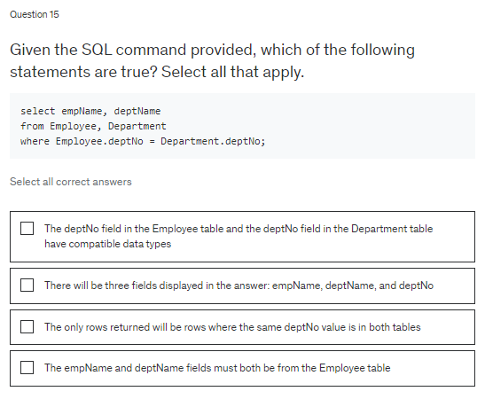

Slide 15
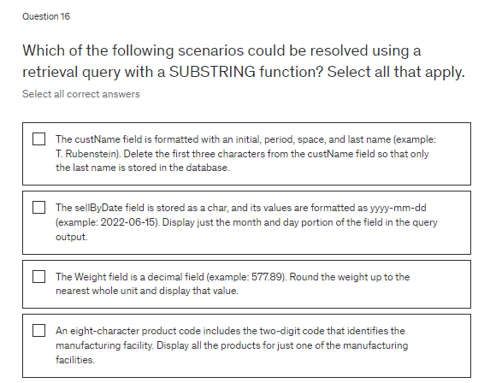

Slide 16
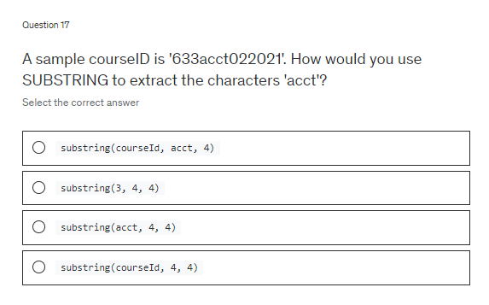

Slide 17


Slide 18
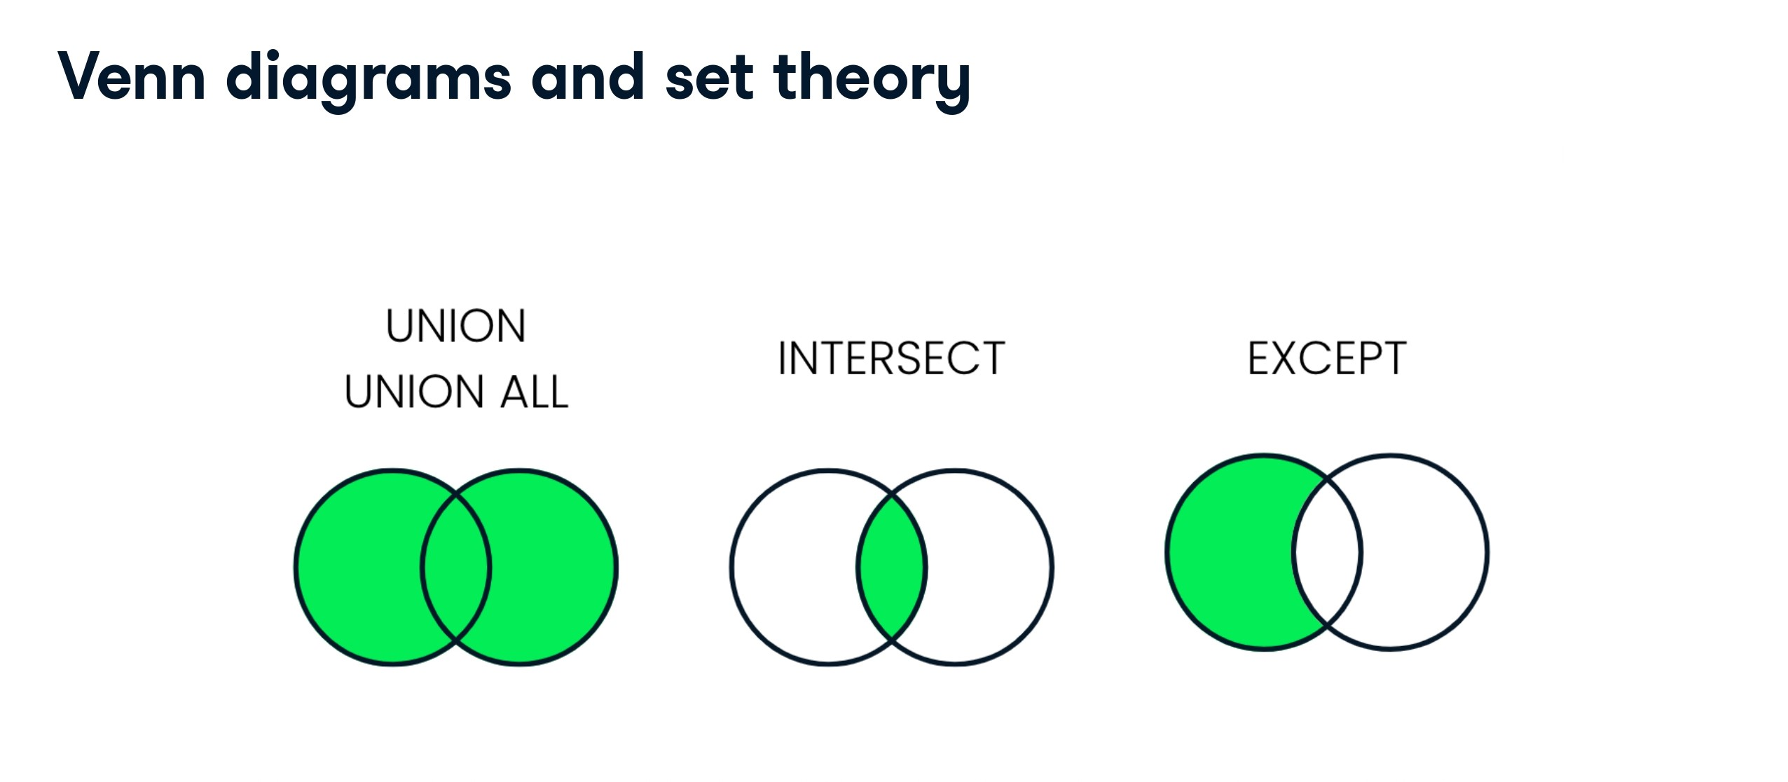

Slide 19
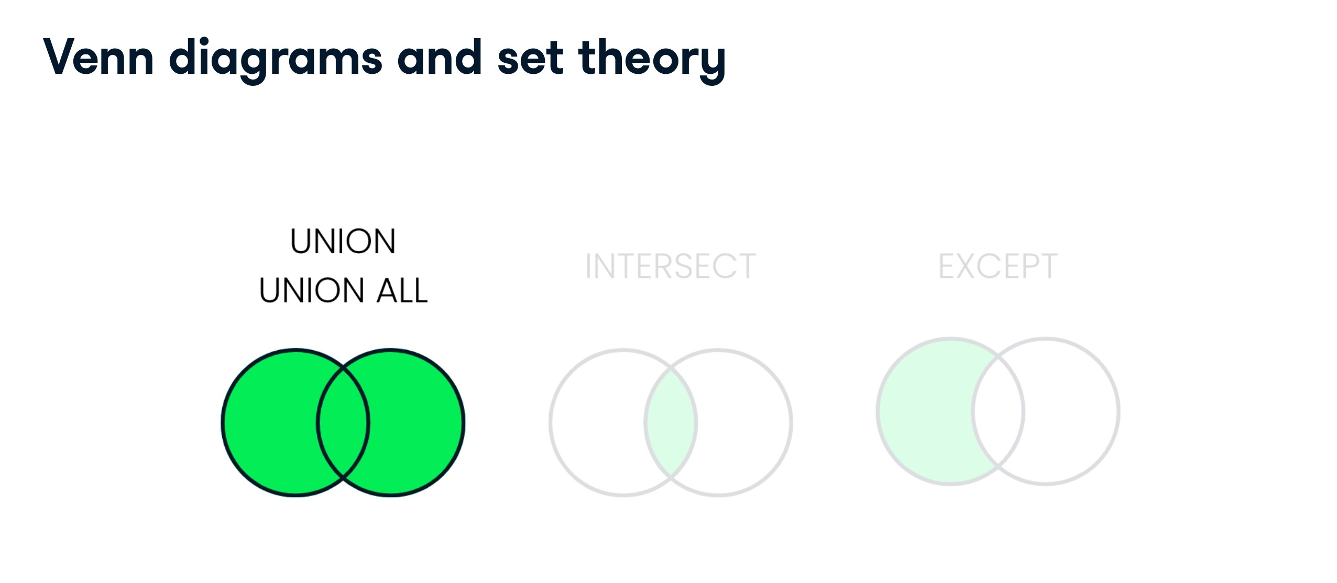

Slide 20
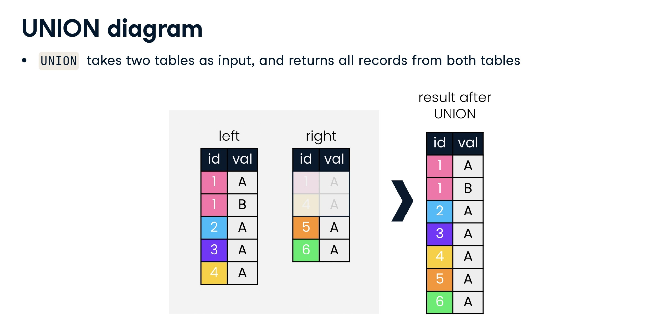

Slide 21
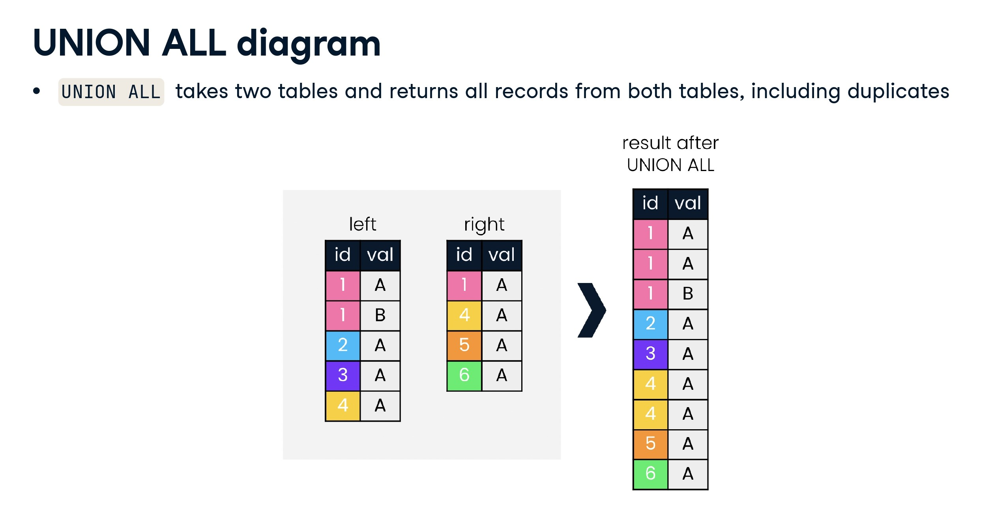

Slide 22
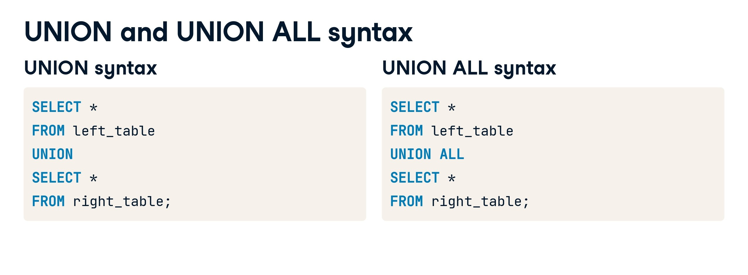

Slide 23
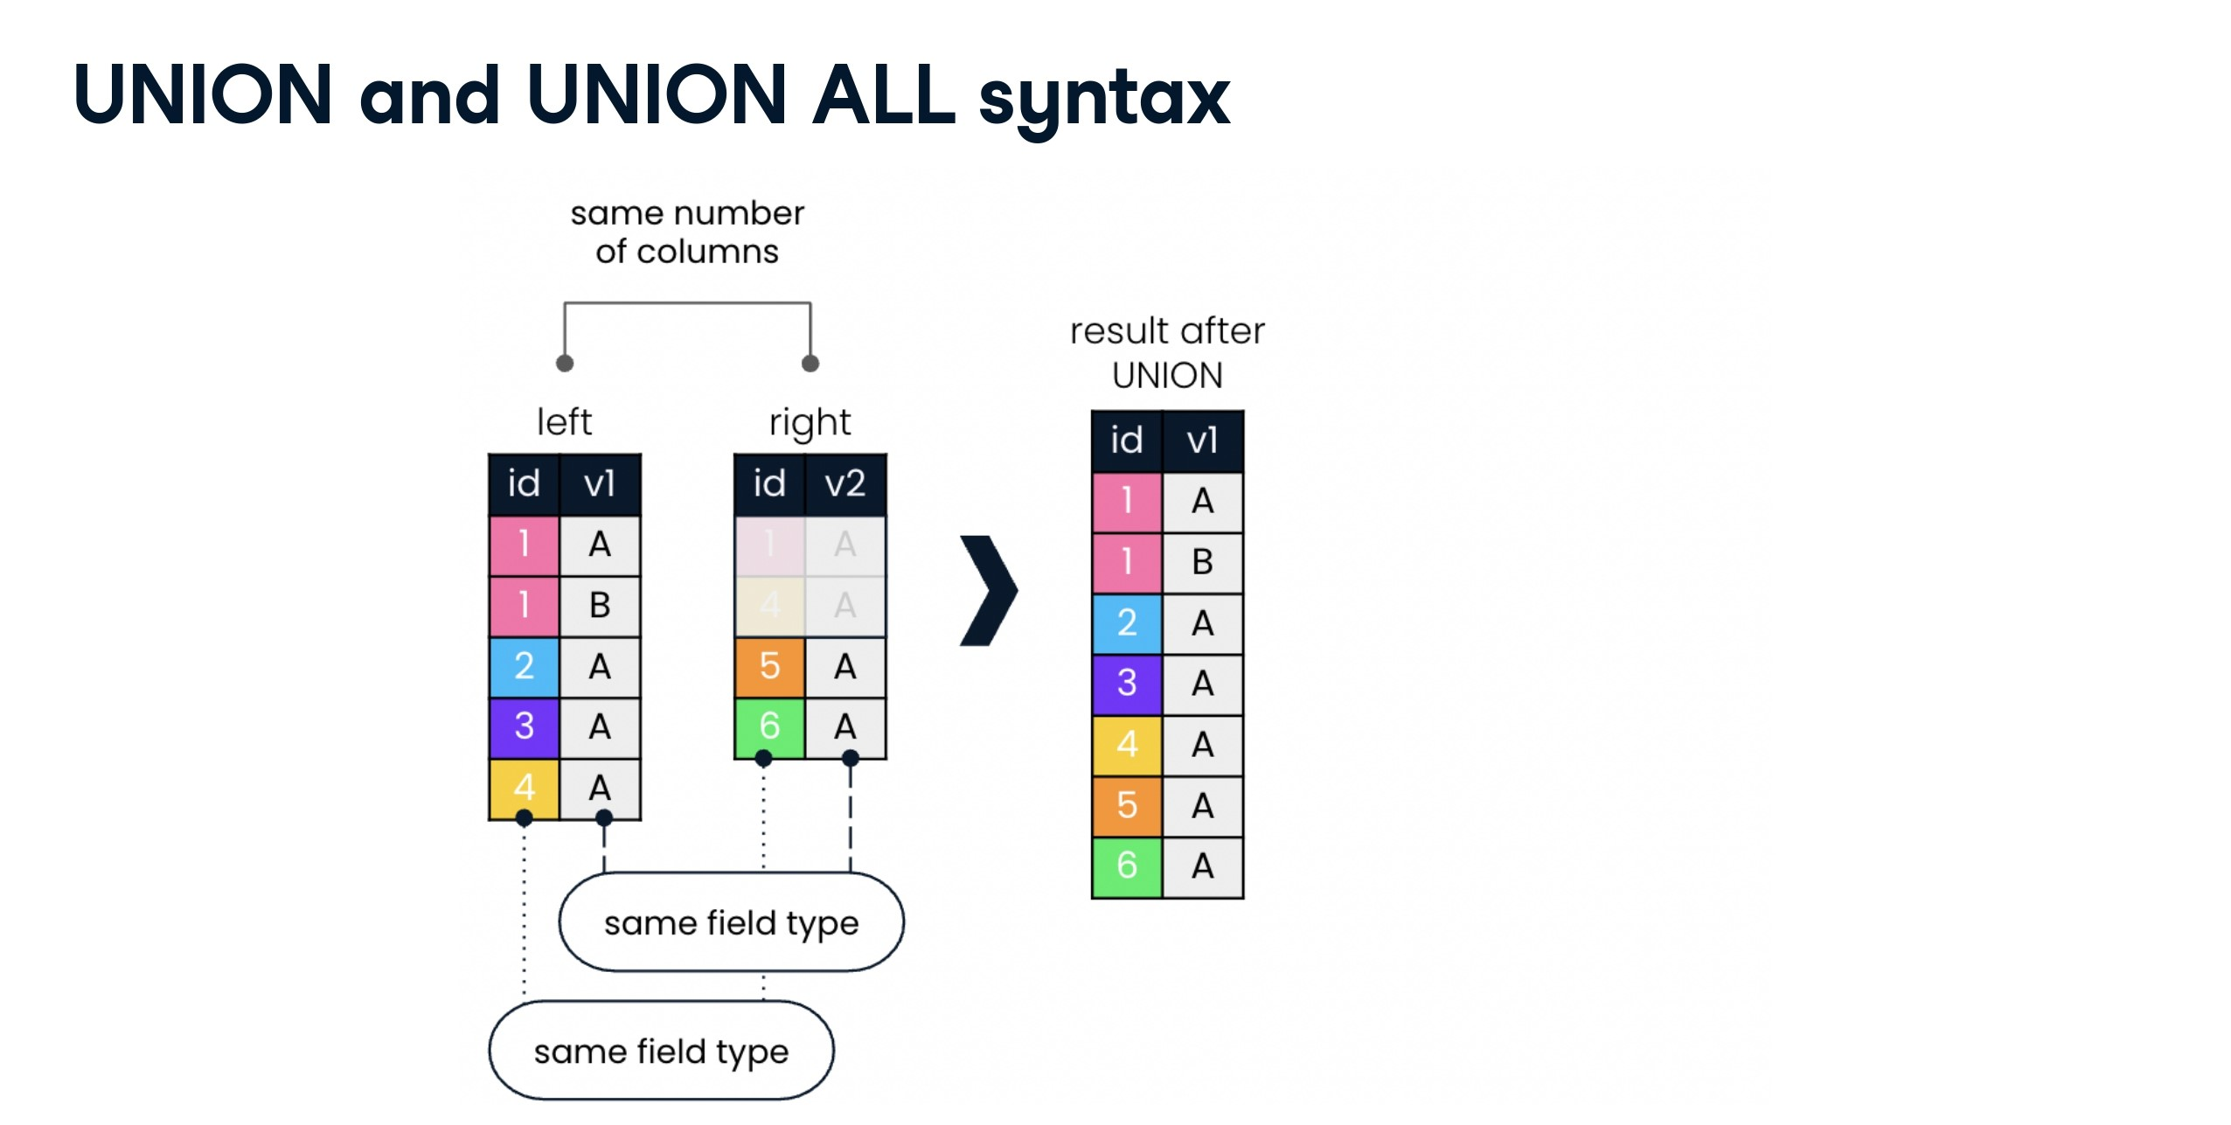

Slide 24
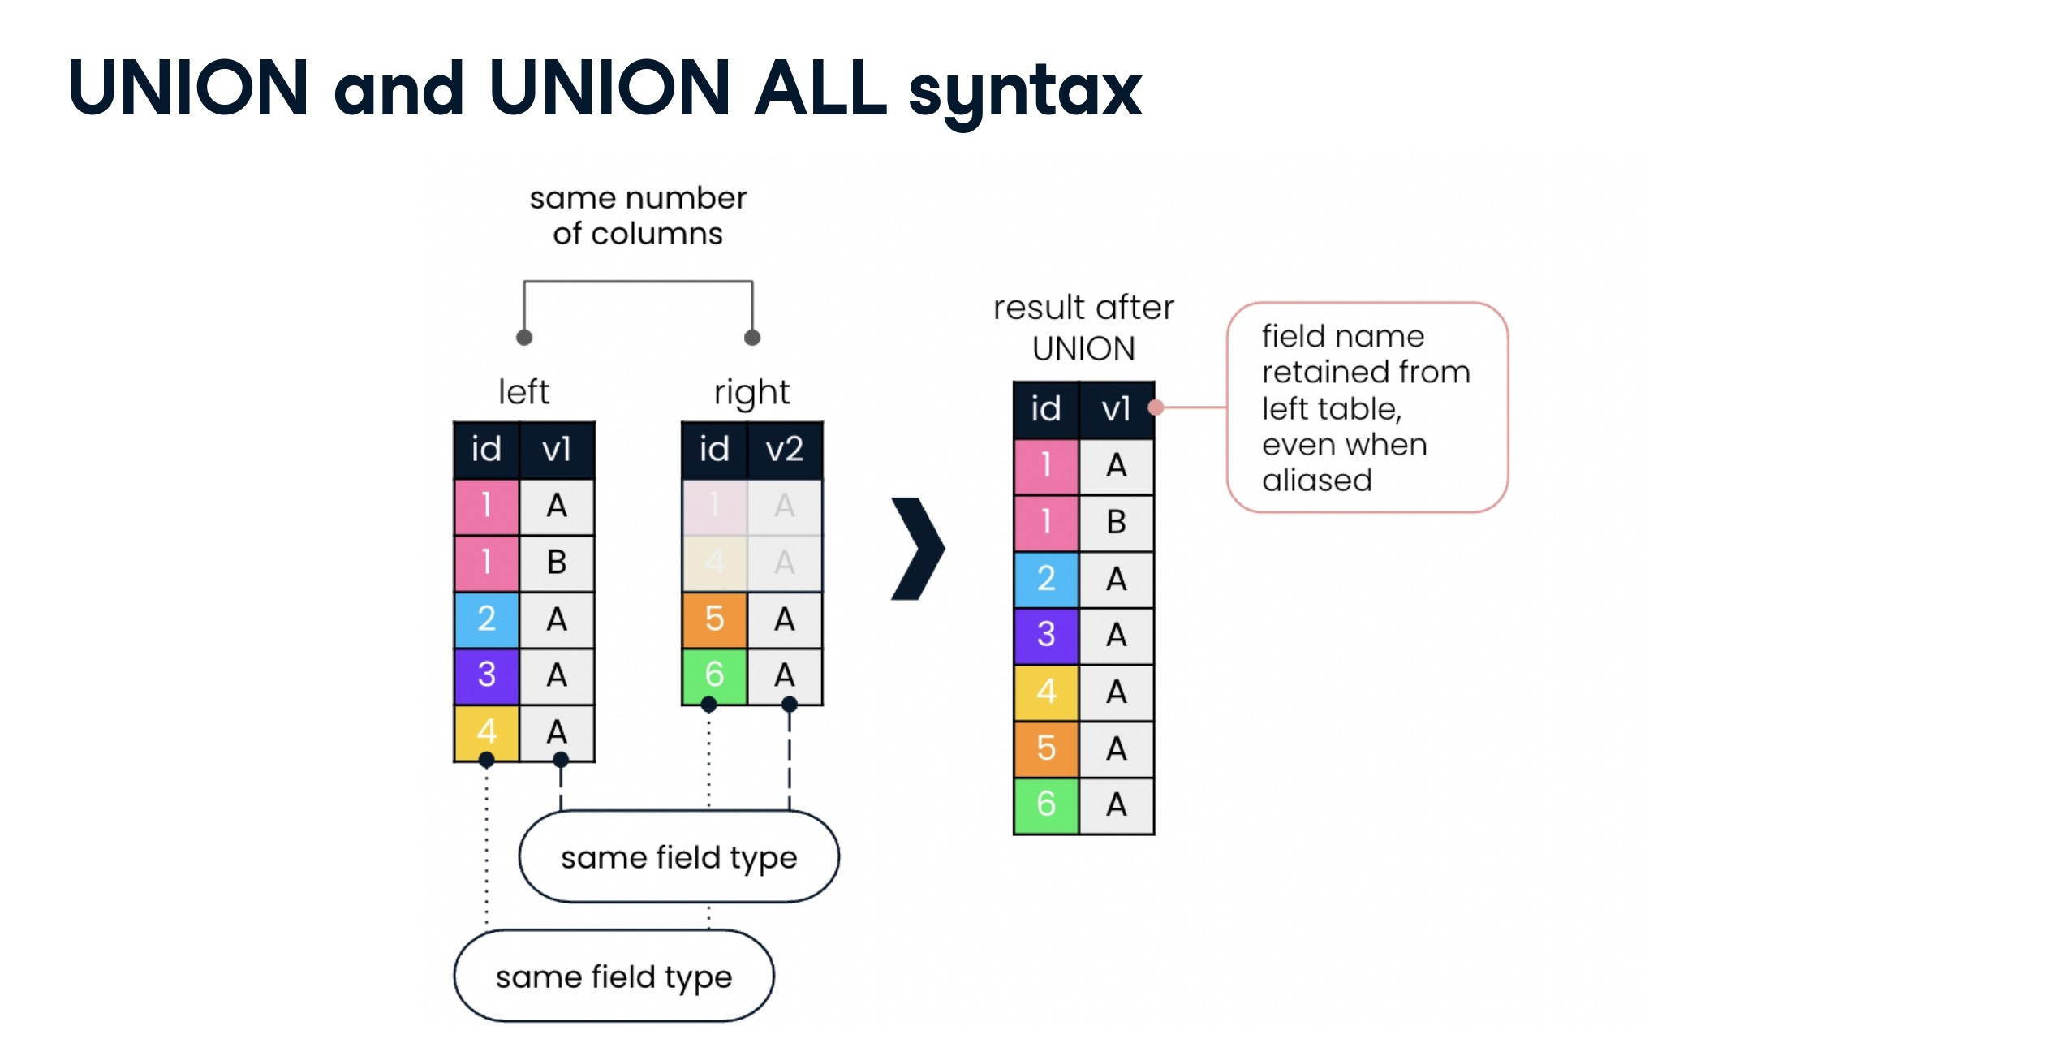

Slide 25
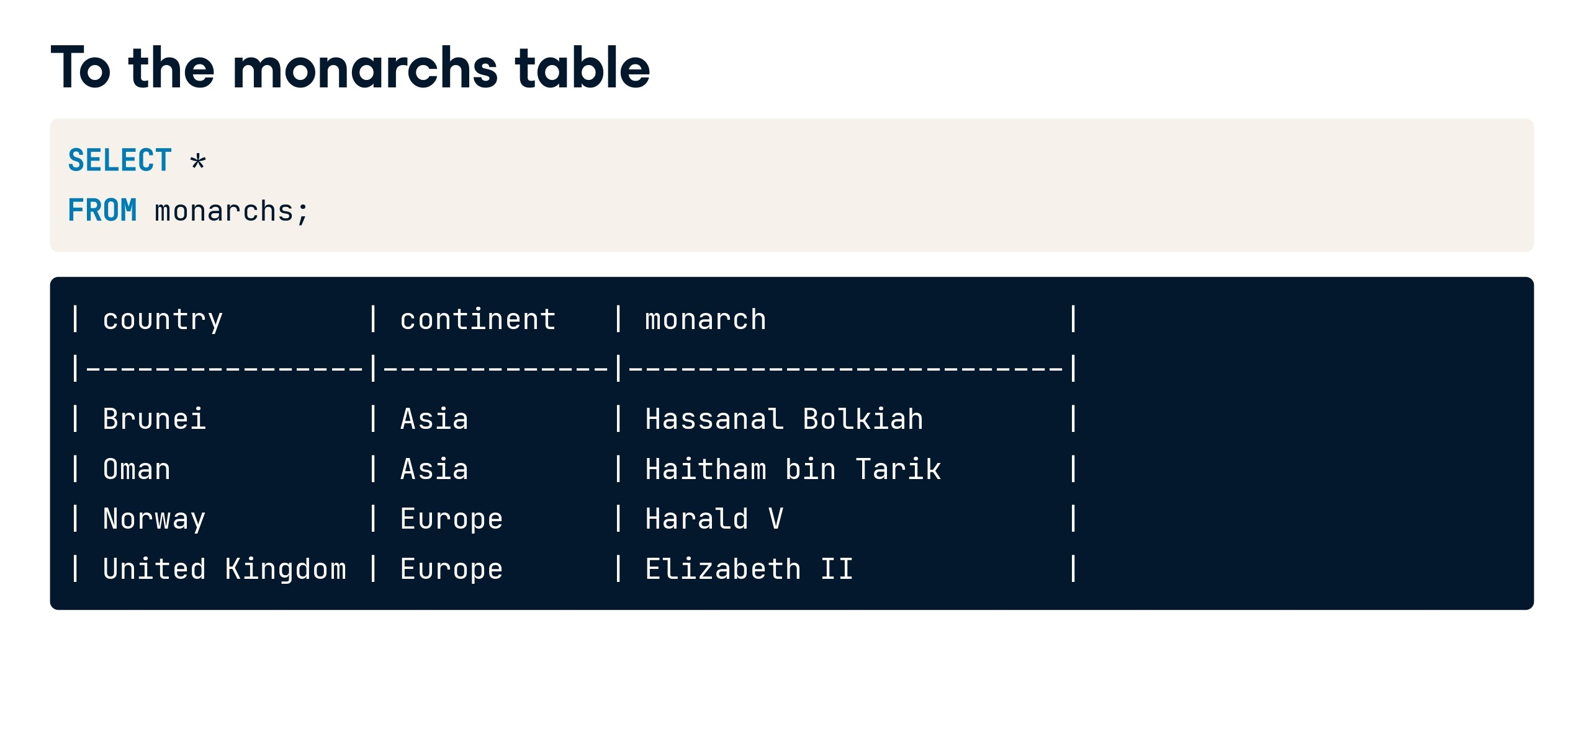

Slide 26
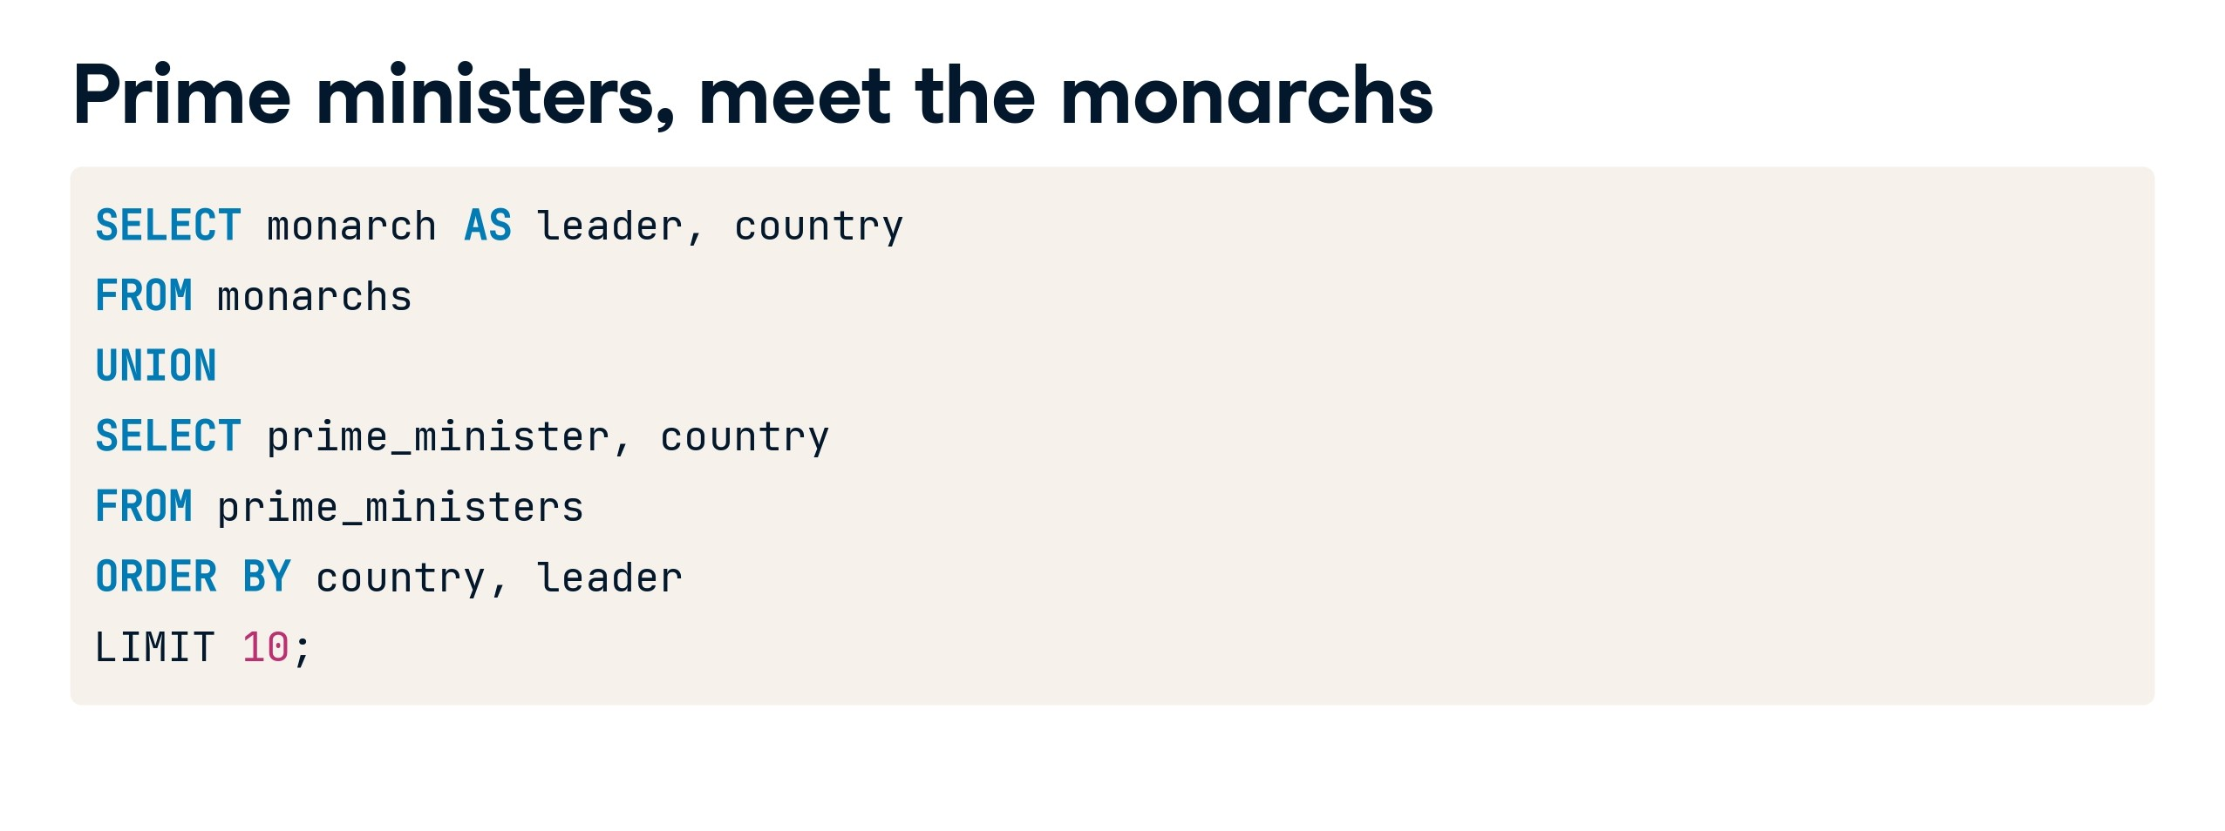

Slide 27
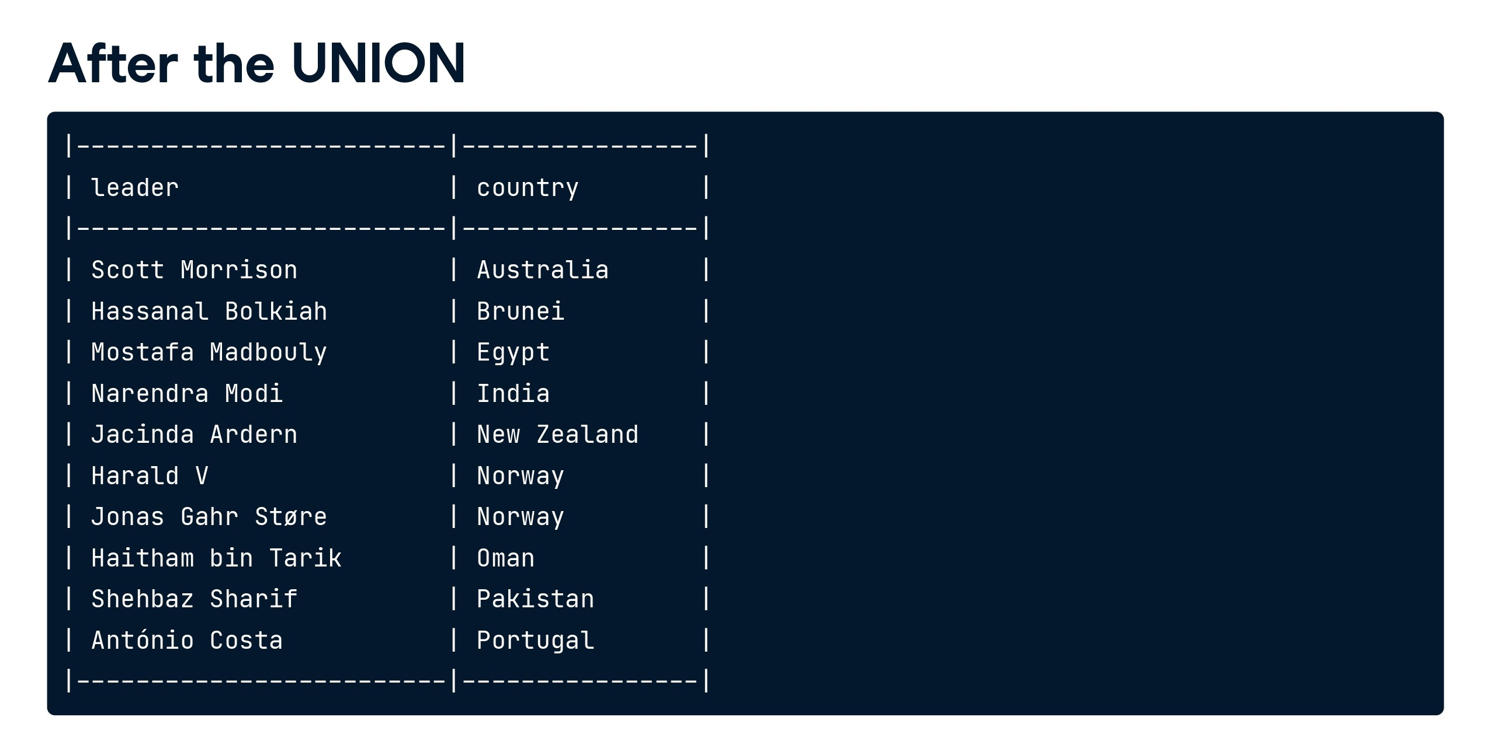

Slide 28
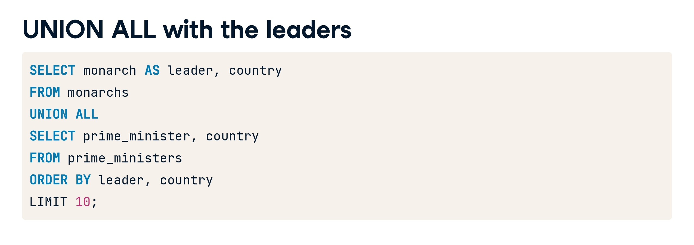

Slide 29
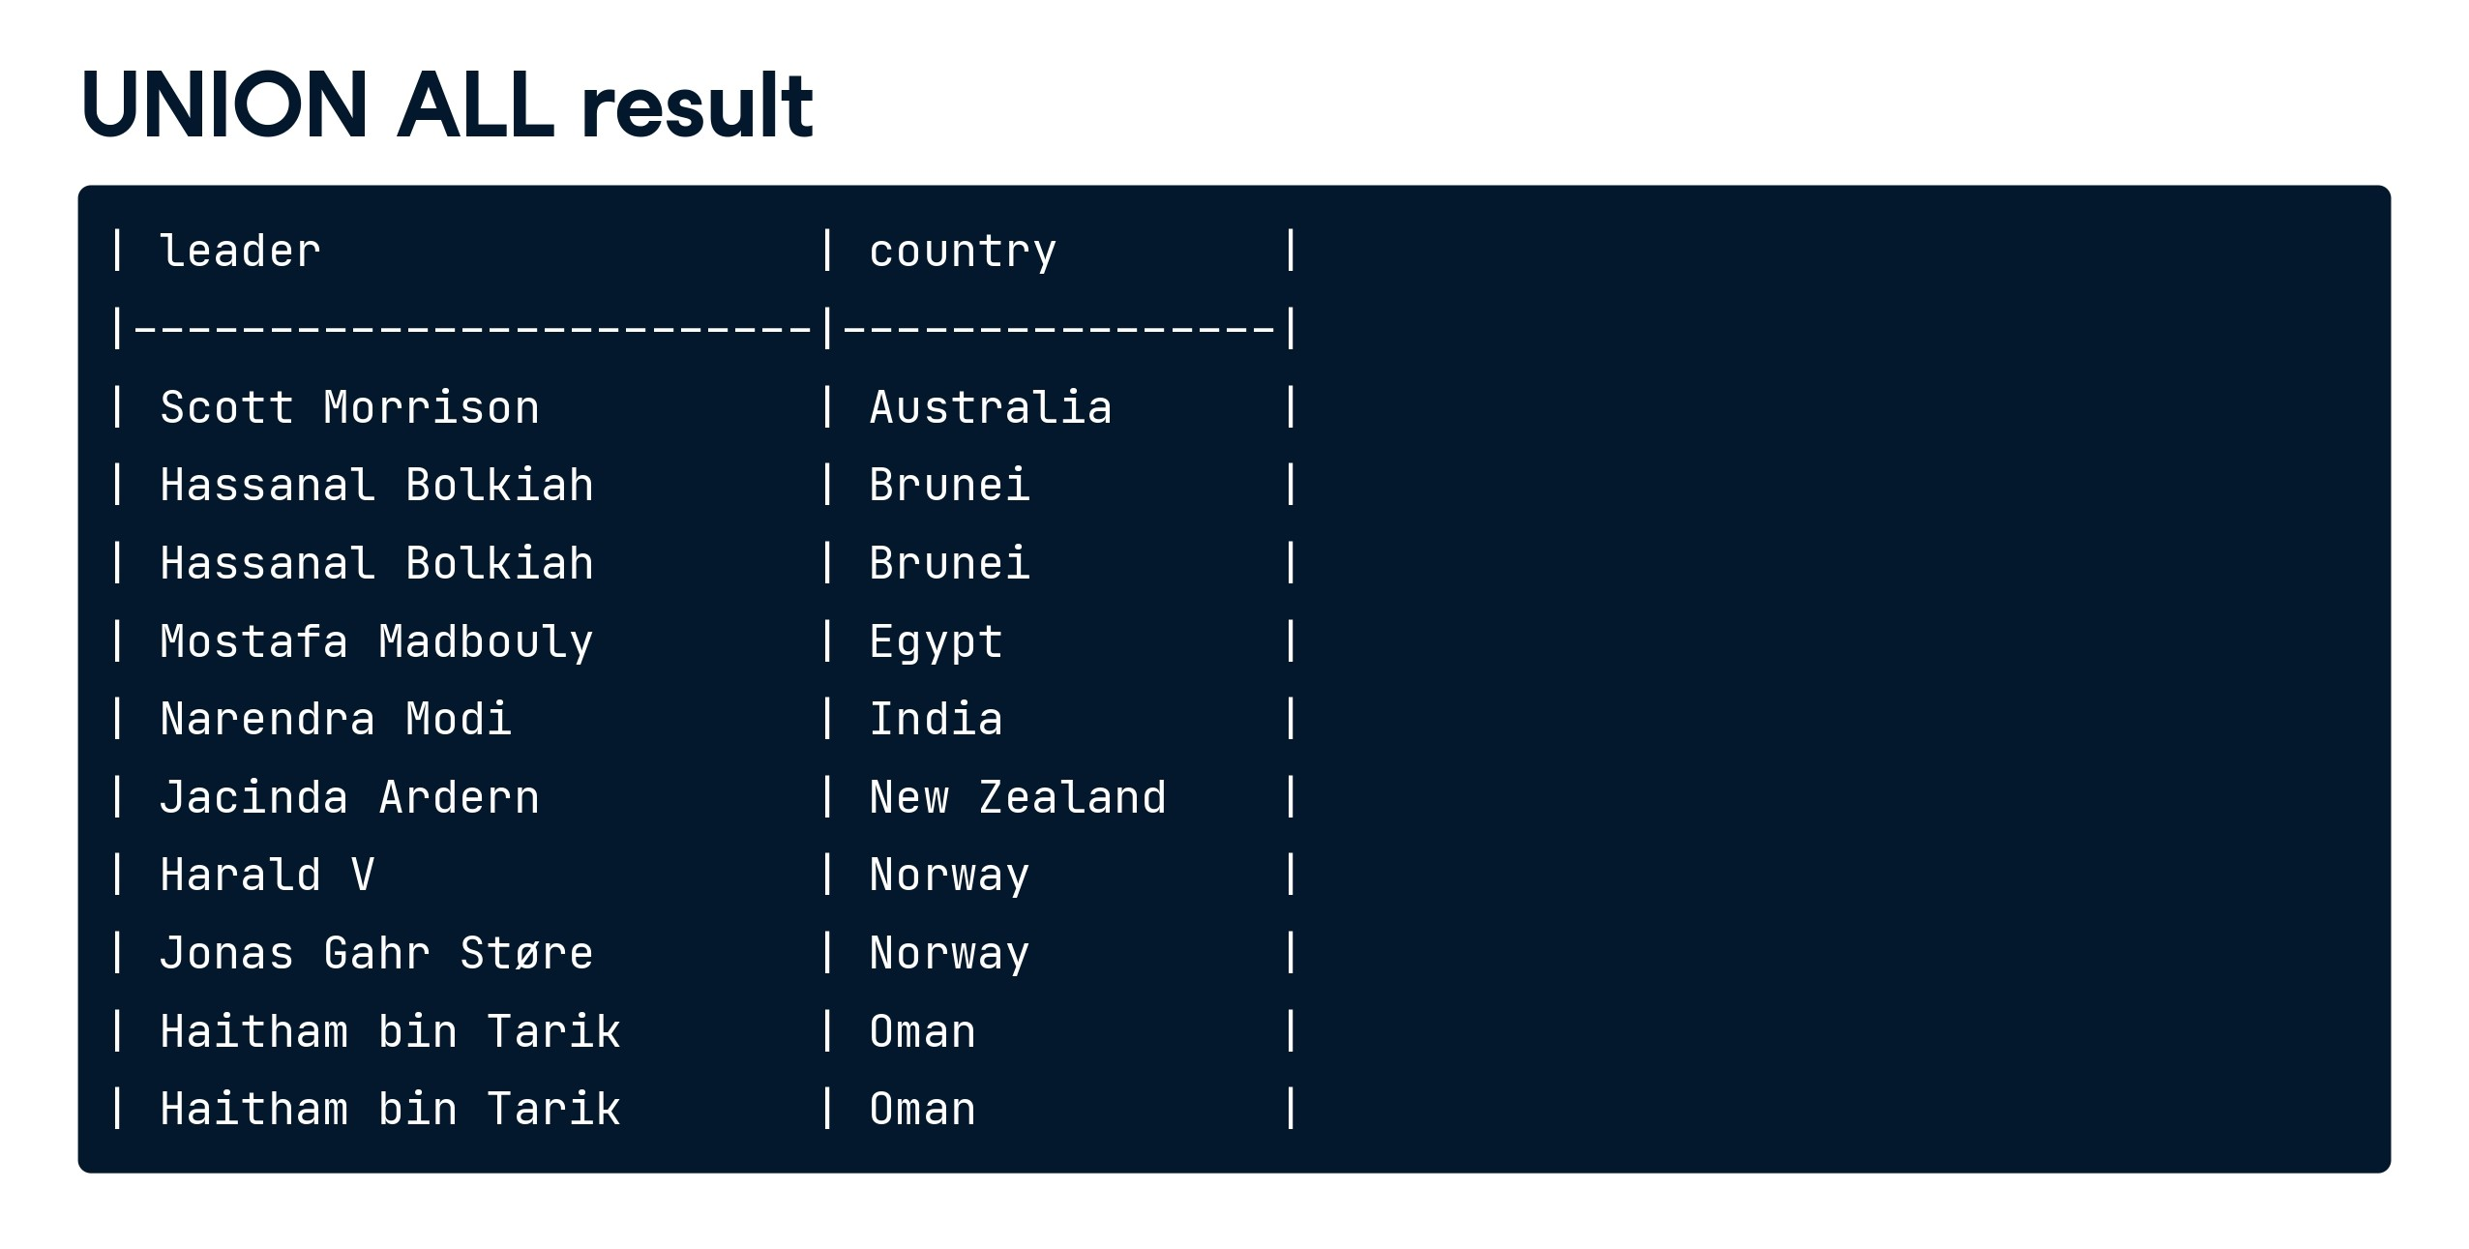

Slide 30


Slide 31
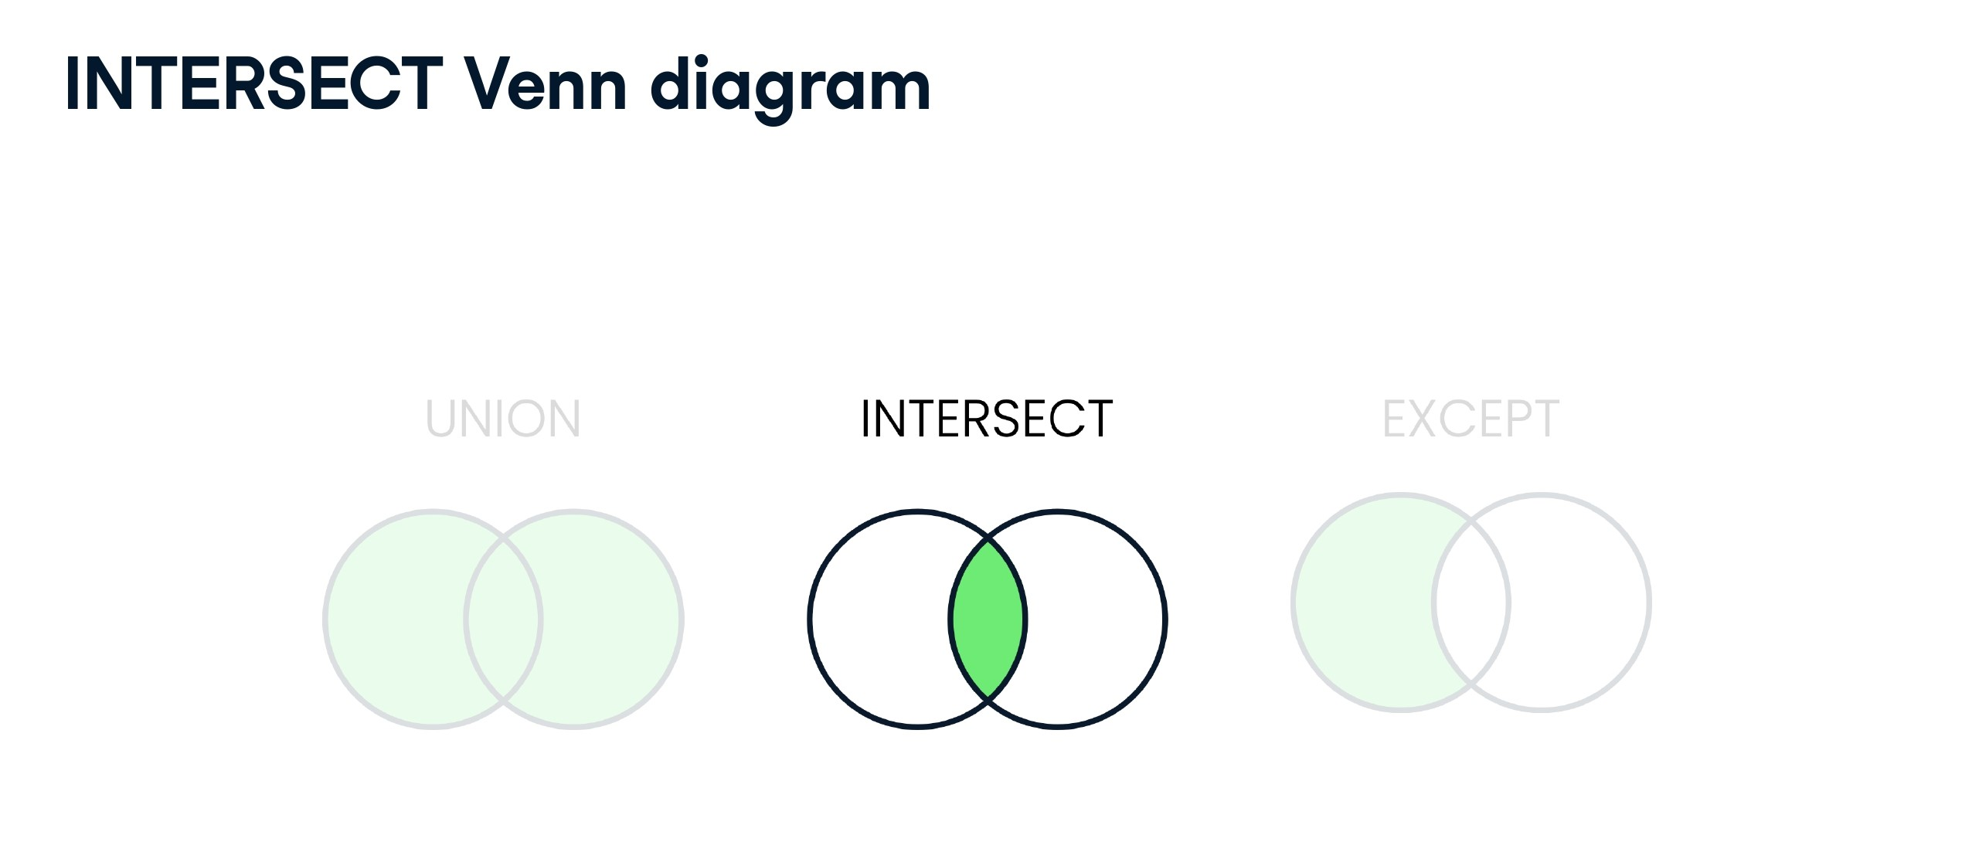

Slide 32
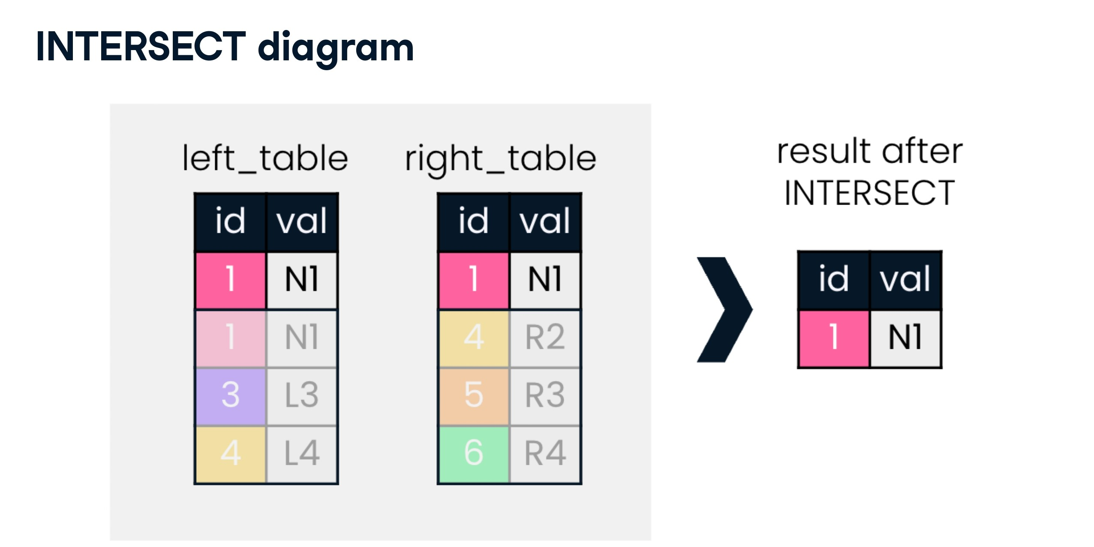

Slide 33
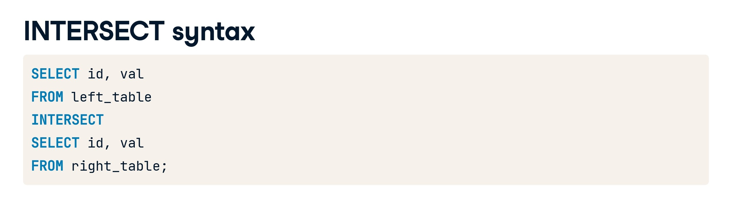

Slide 34
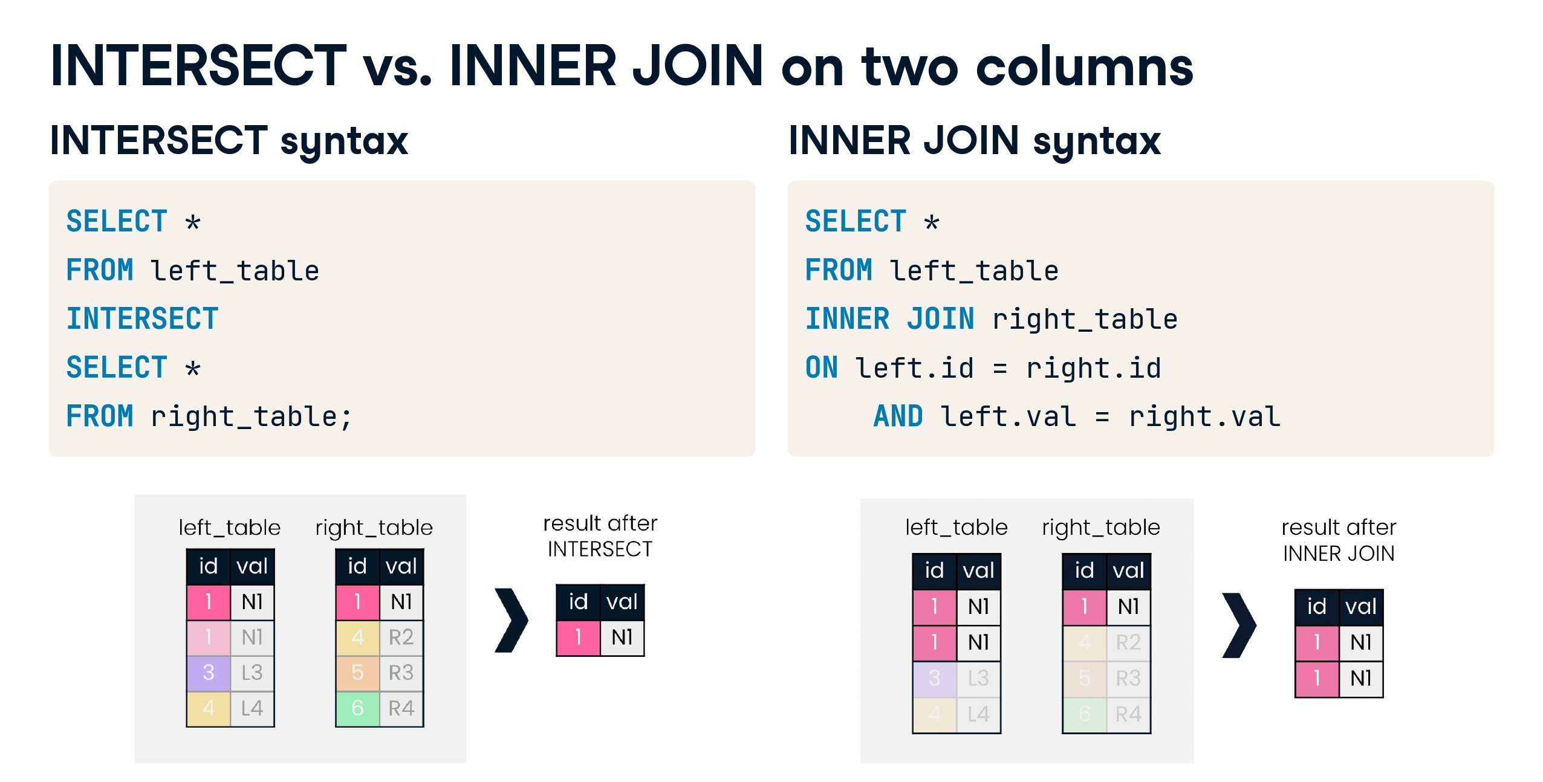

Slide 35
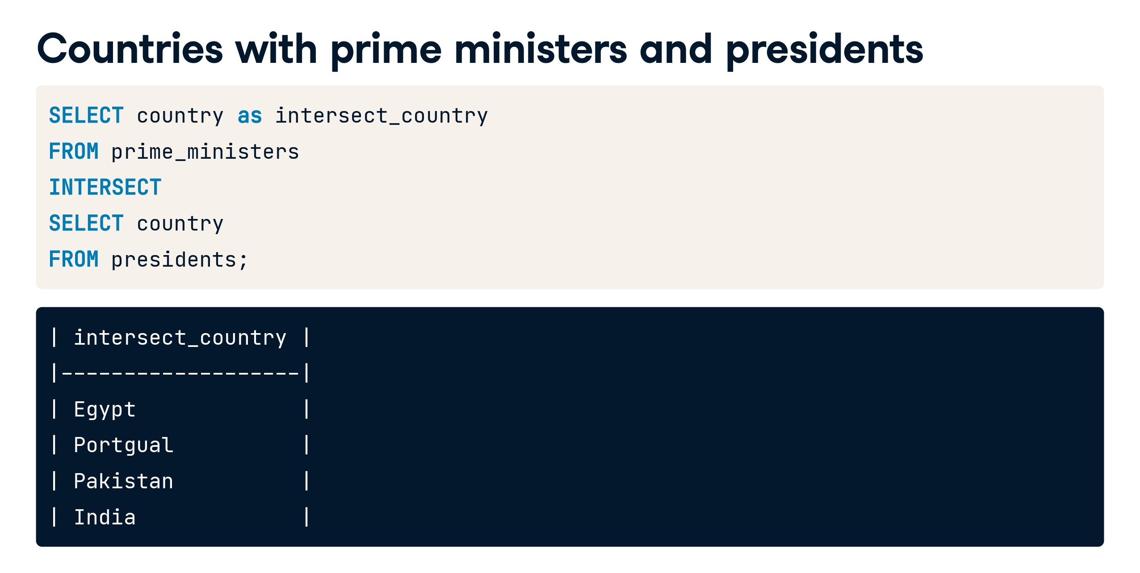

Slide 36
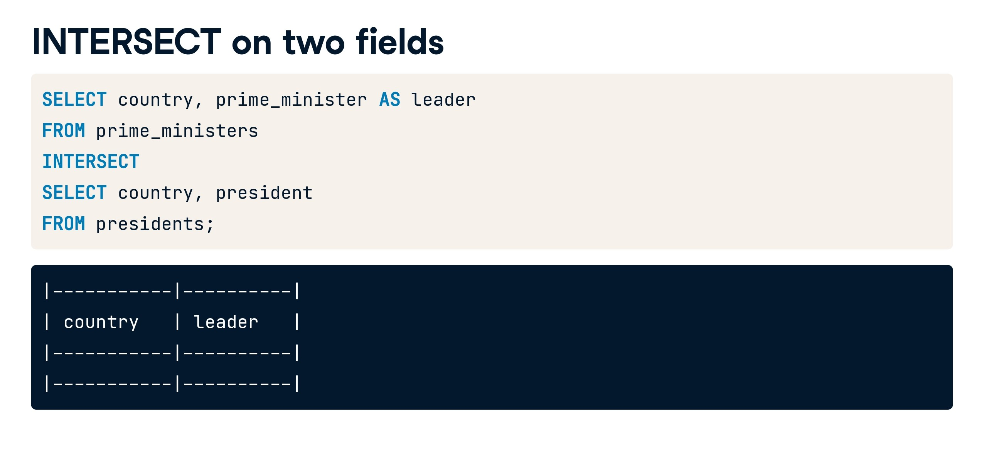

Slide 37
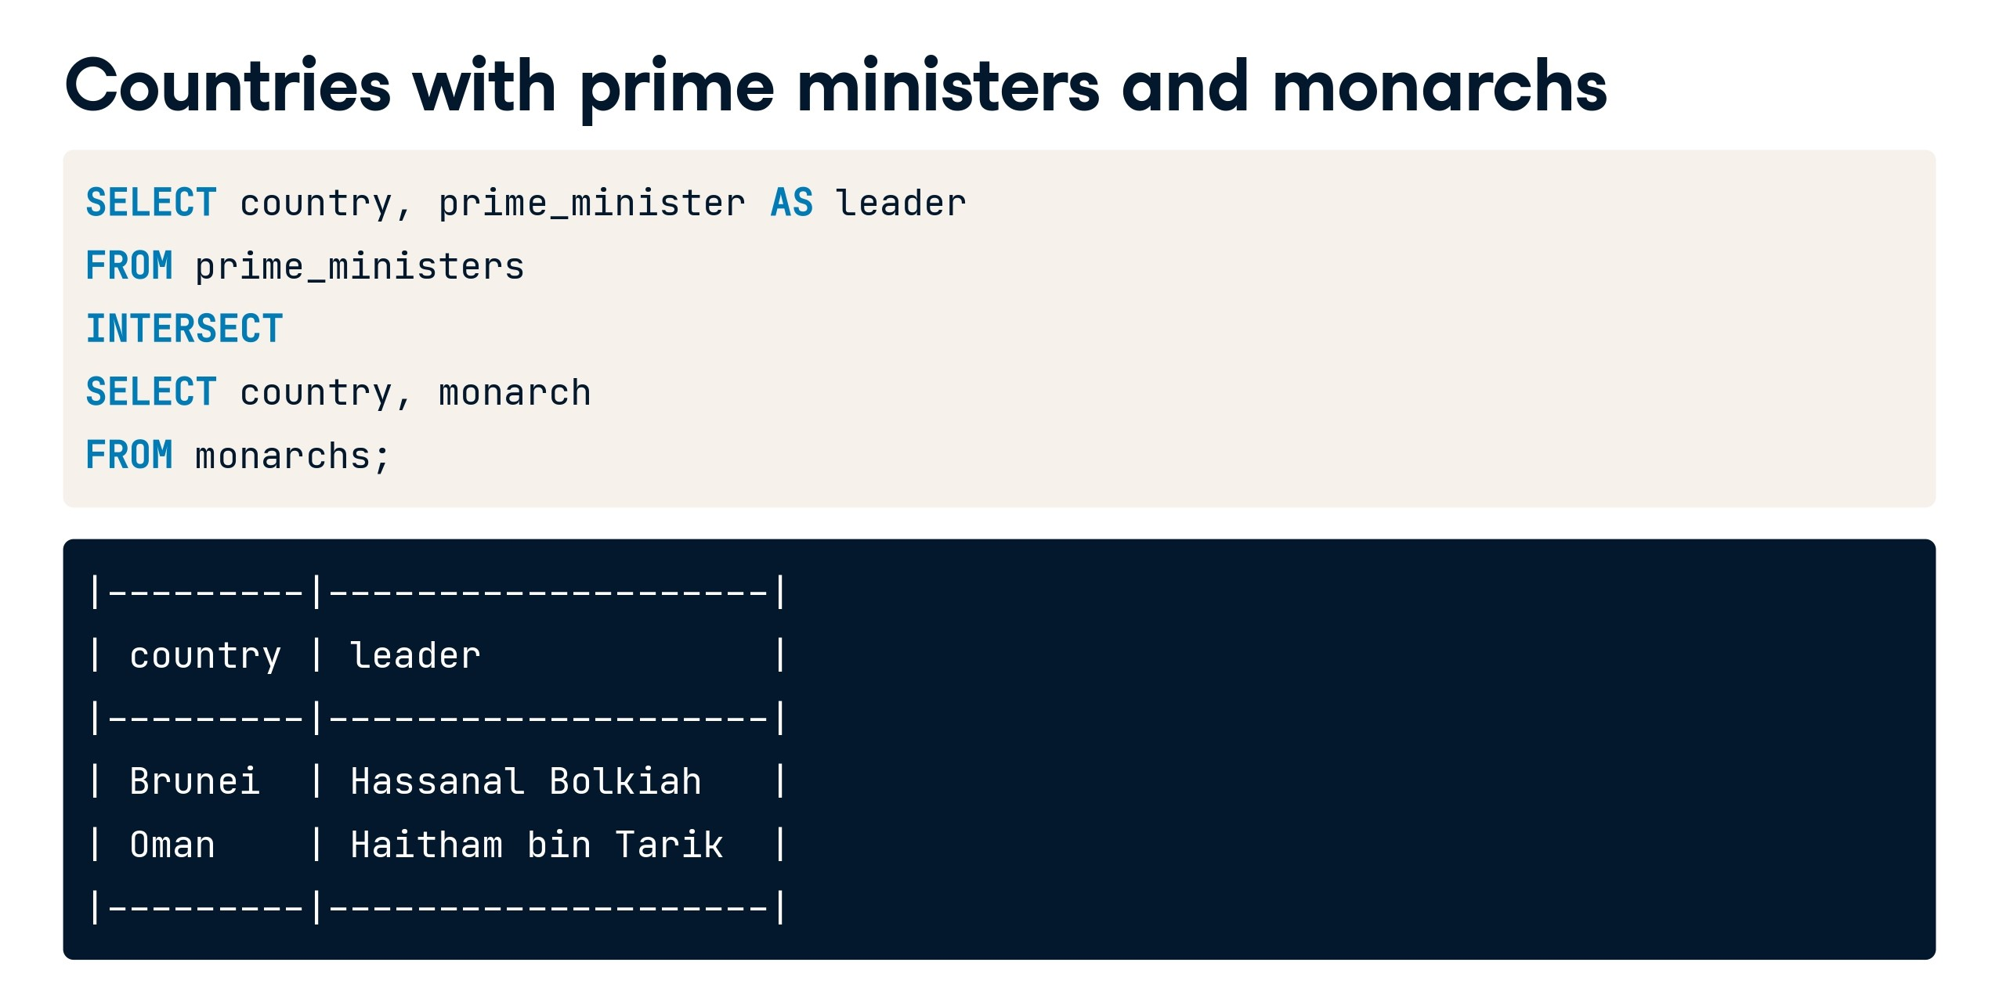

Slide 38


Slide 39
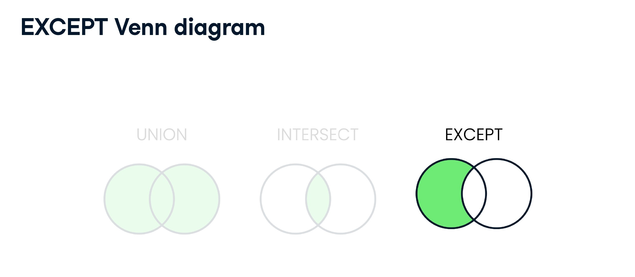

Slide 40
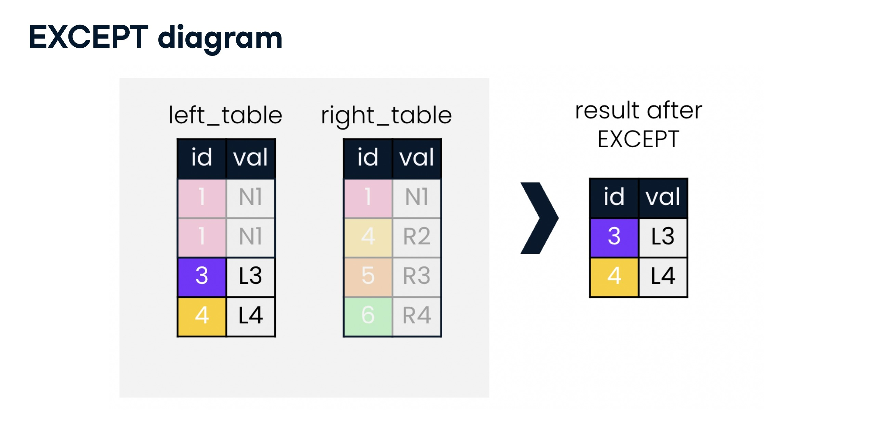

Slide 41
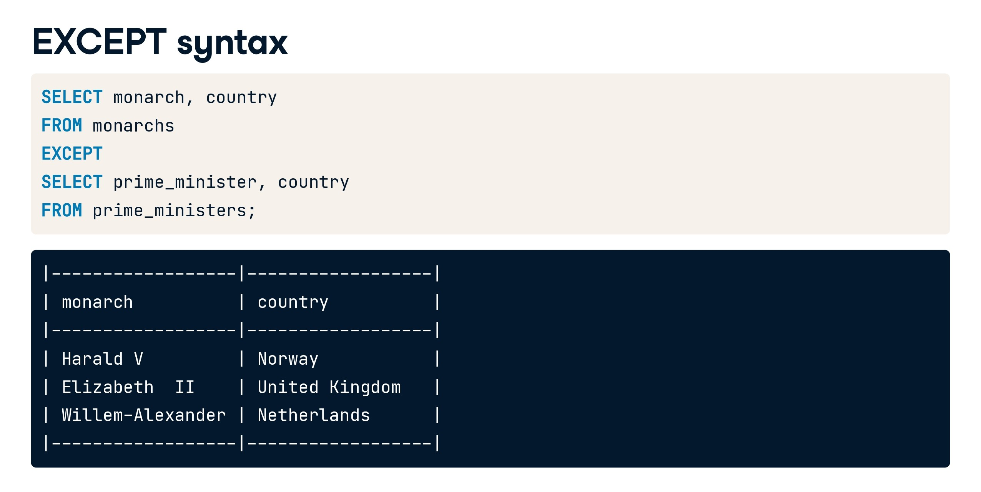

Slide 42


Slide 43
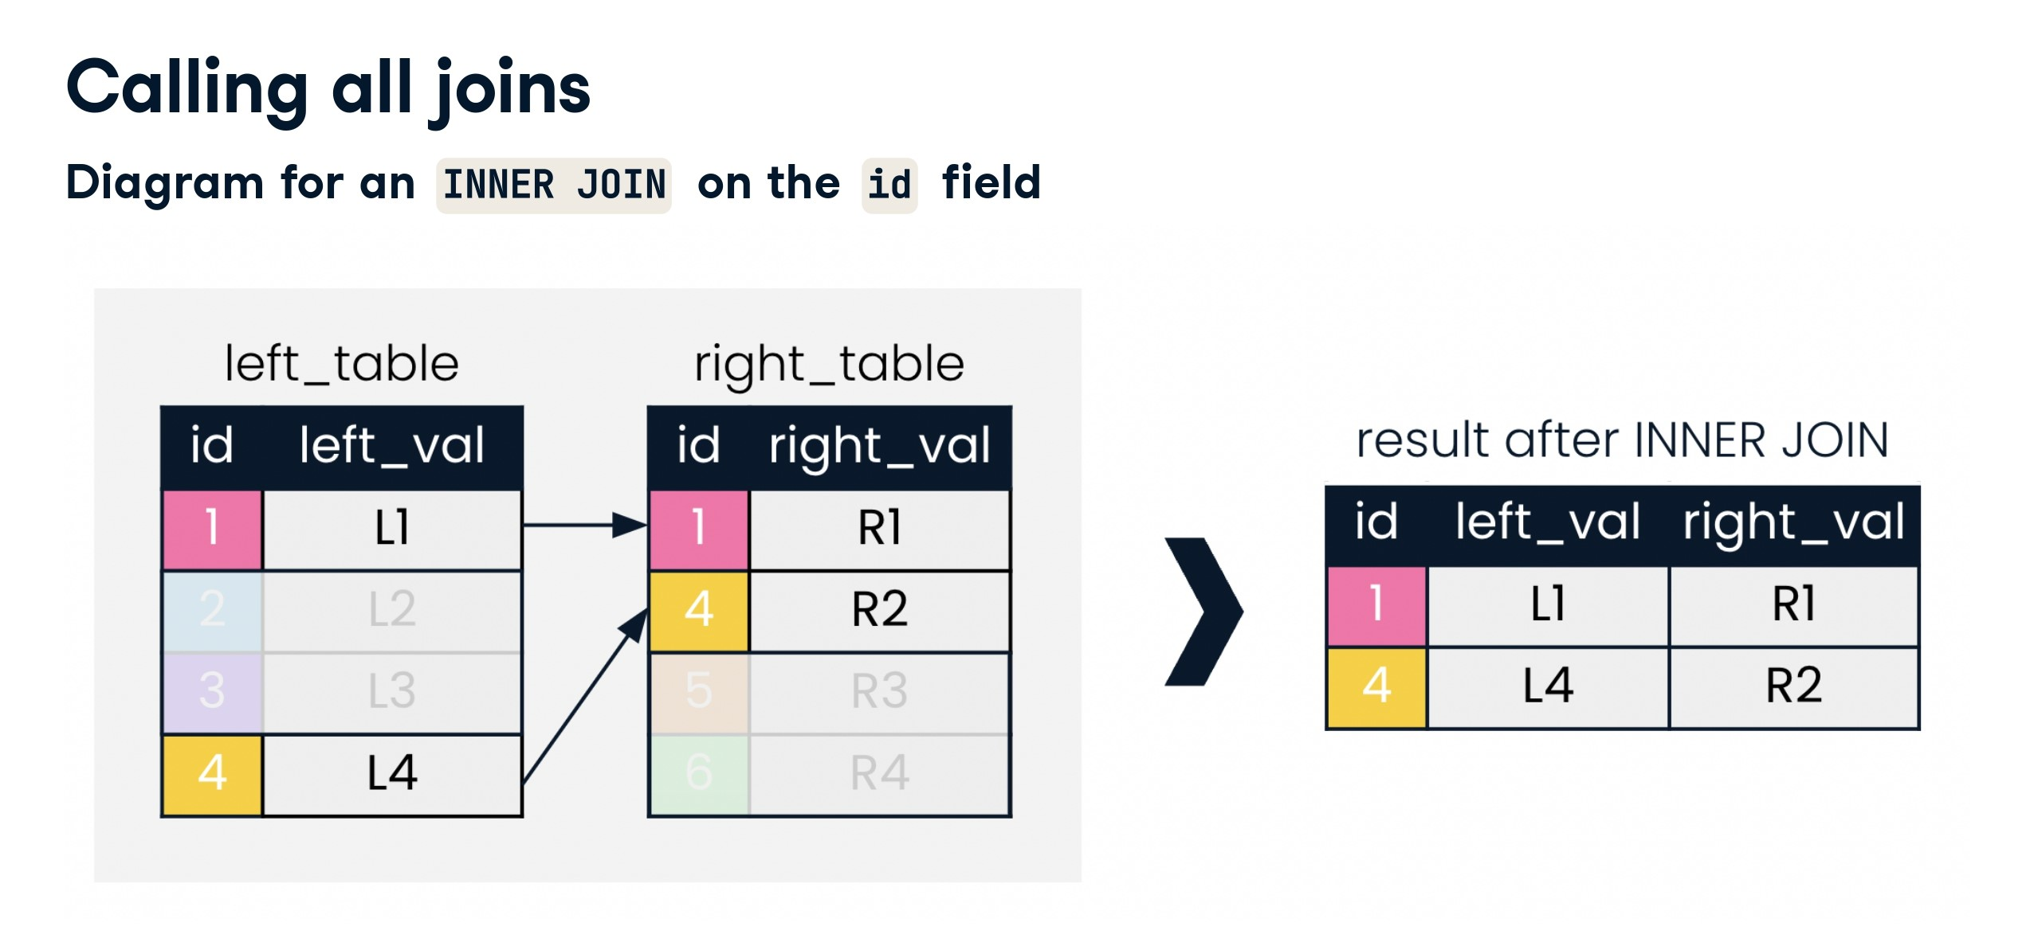

Slide 44
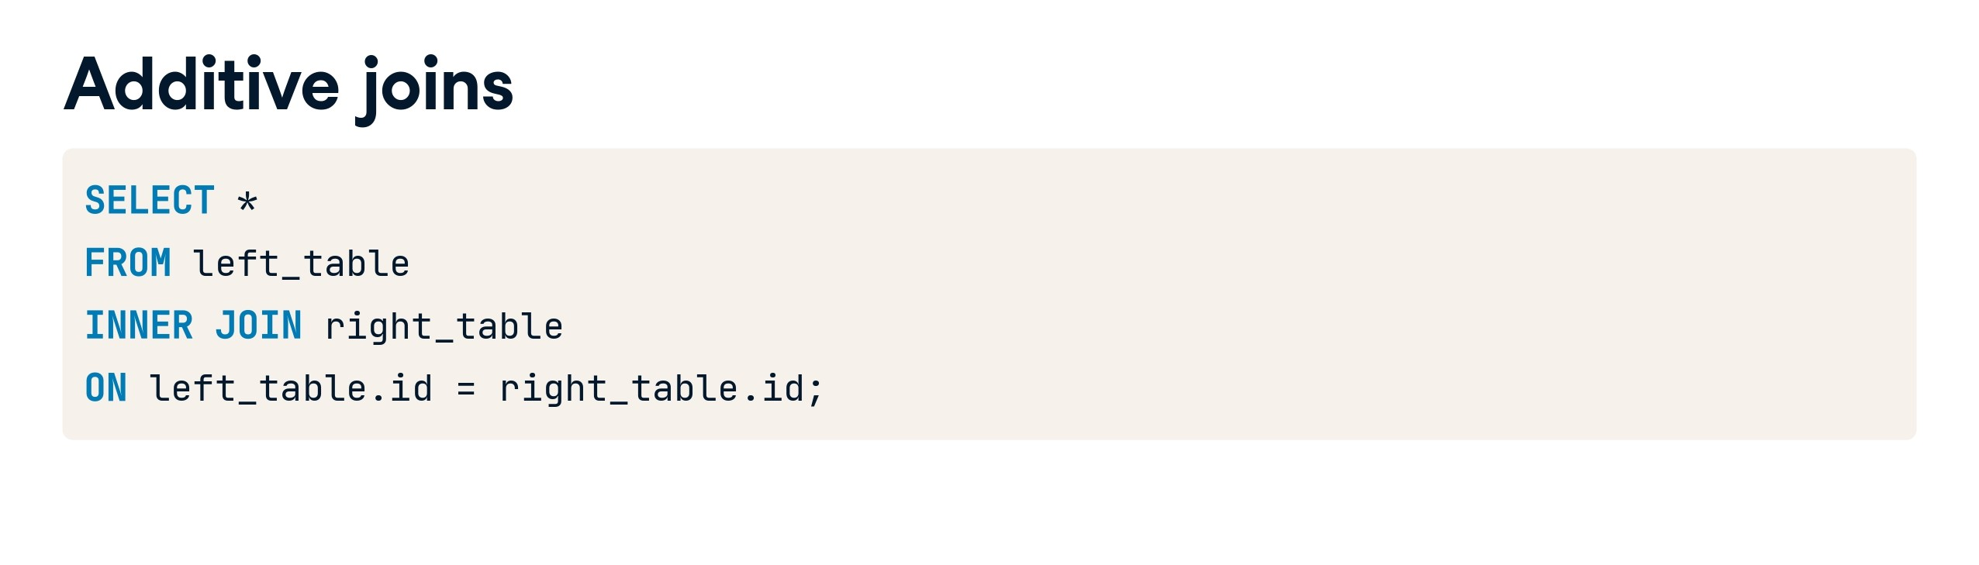

Slide 45
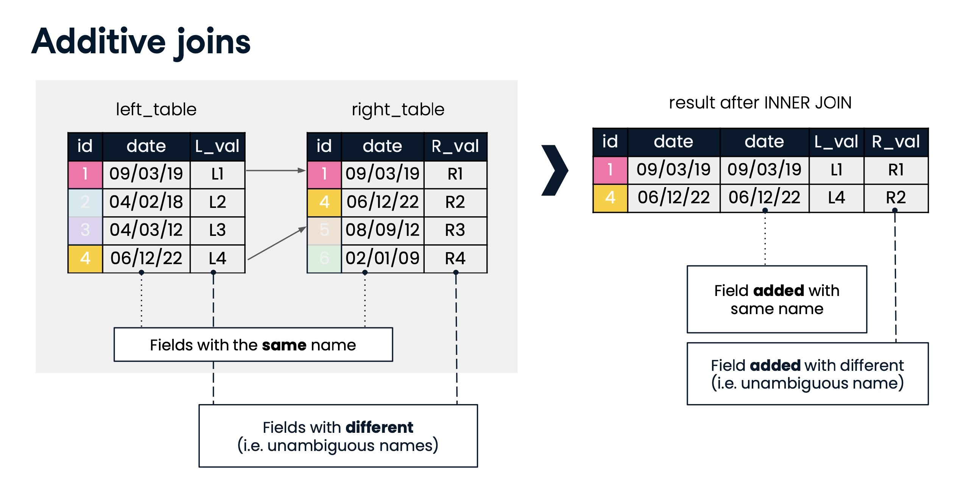

Slide 46
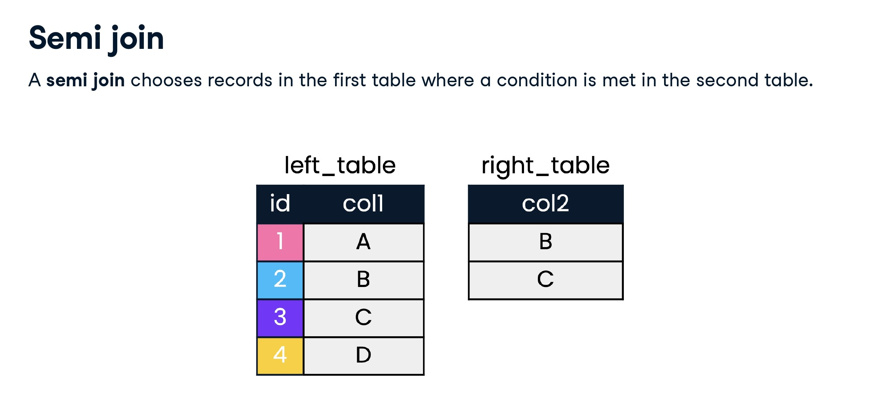

Slide 47
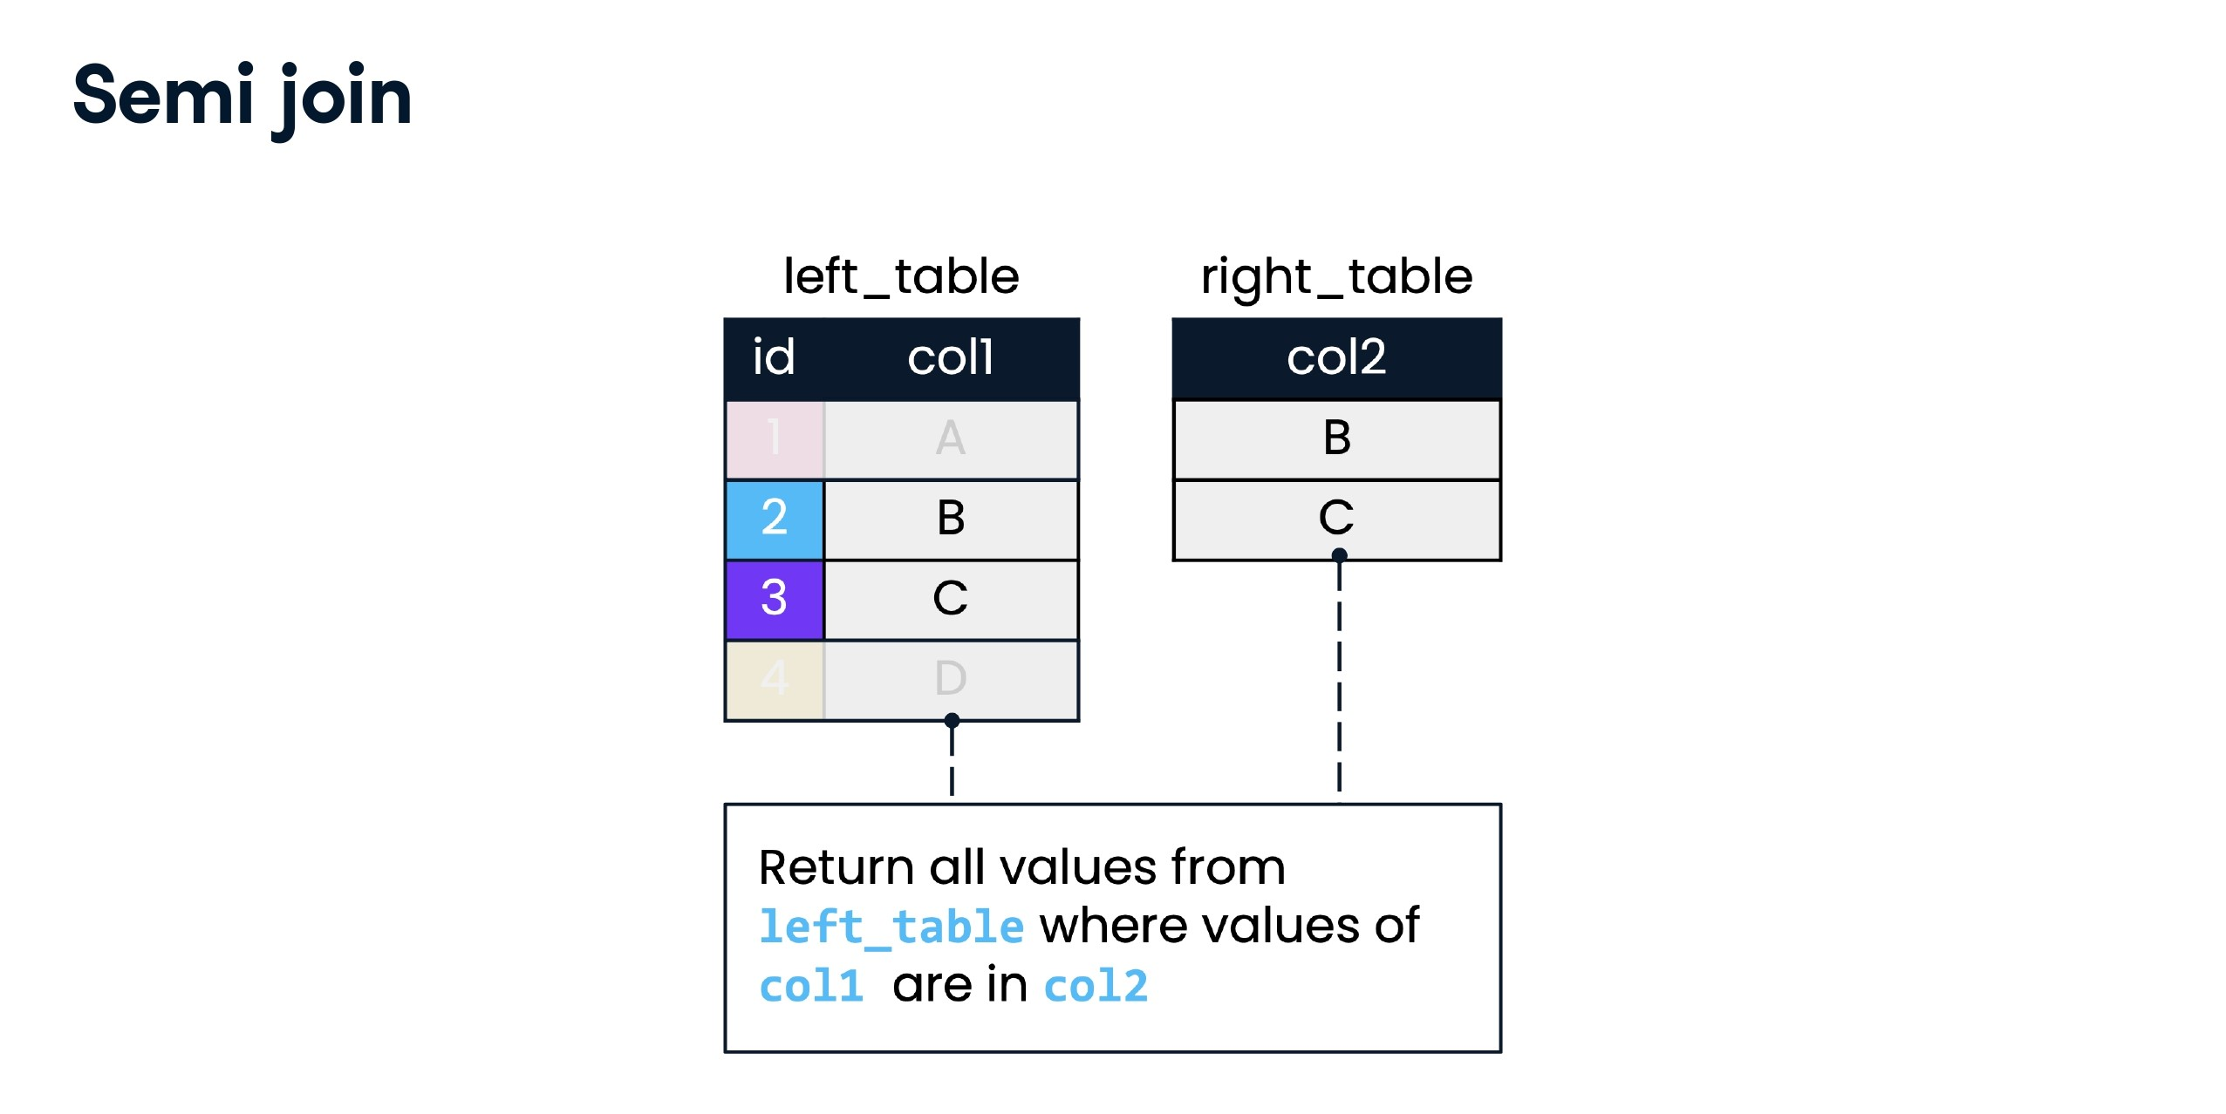

Slide 48
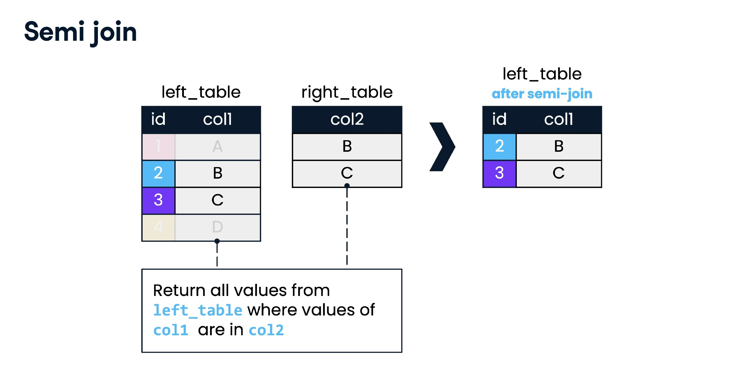

Slide 49
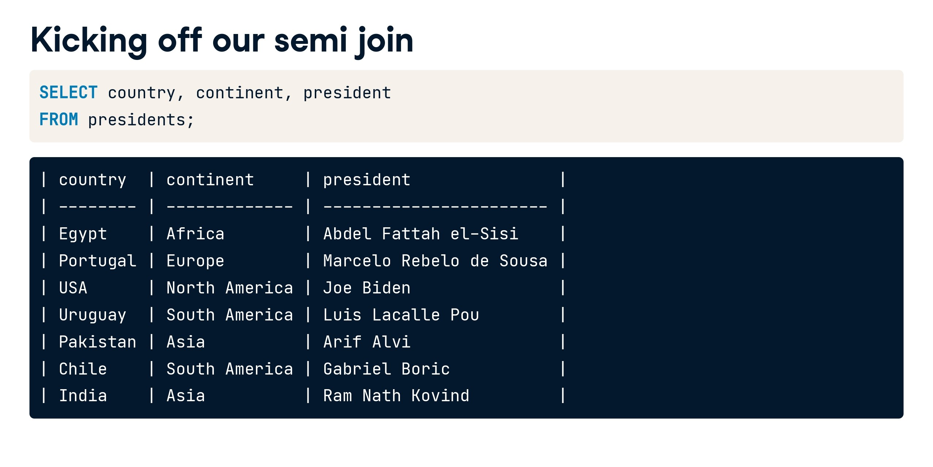

Slide 50
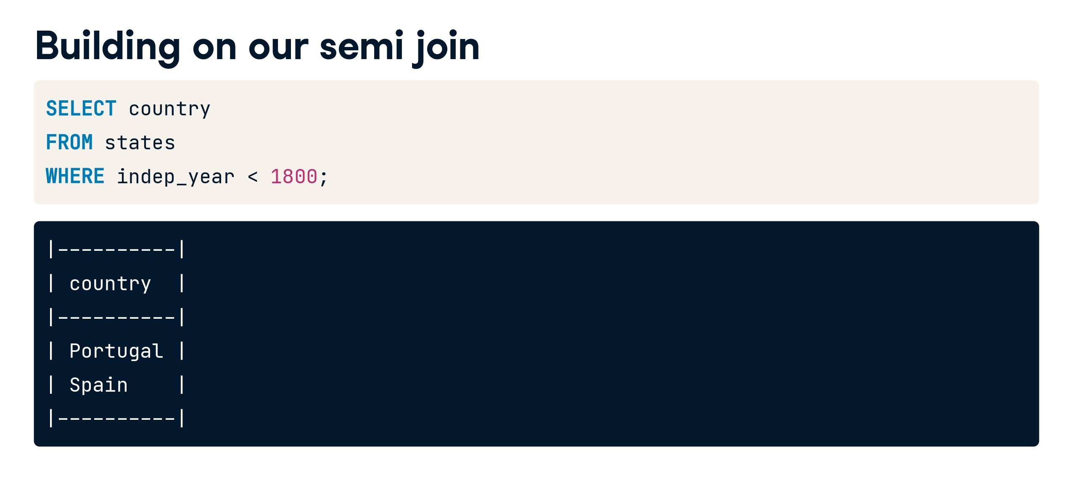

Slide 51
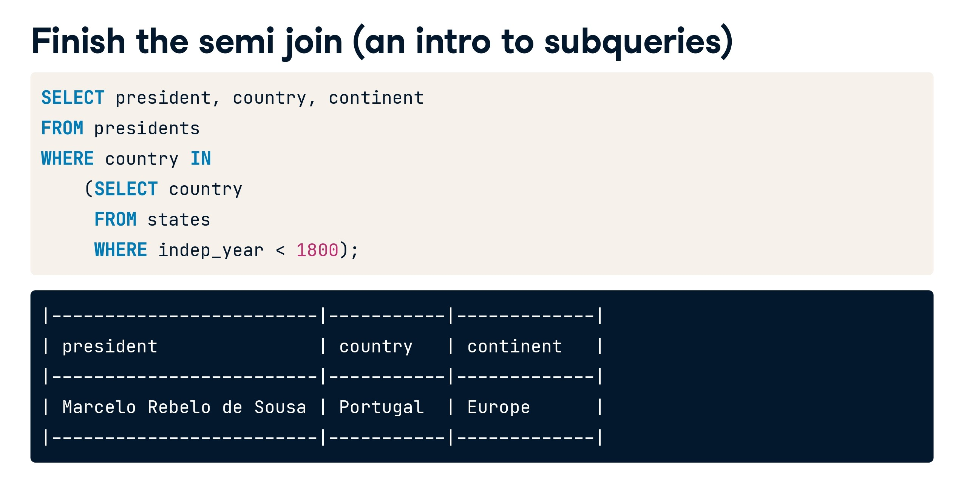

Slide 52
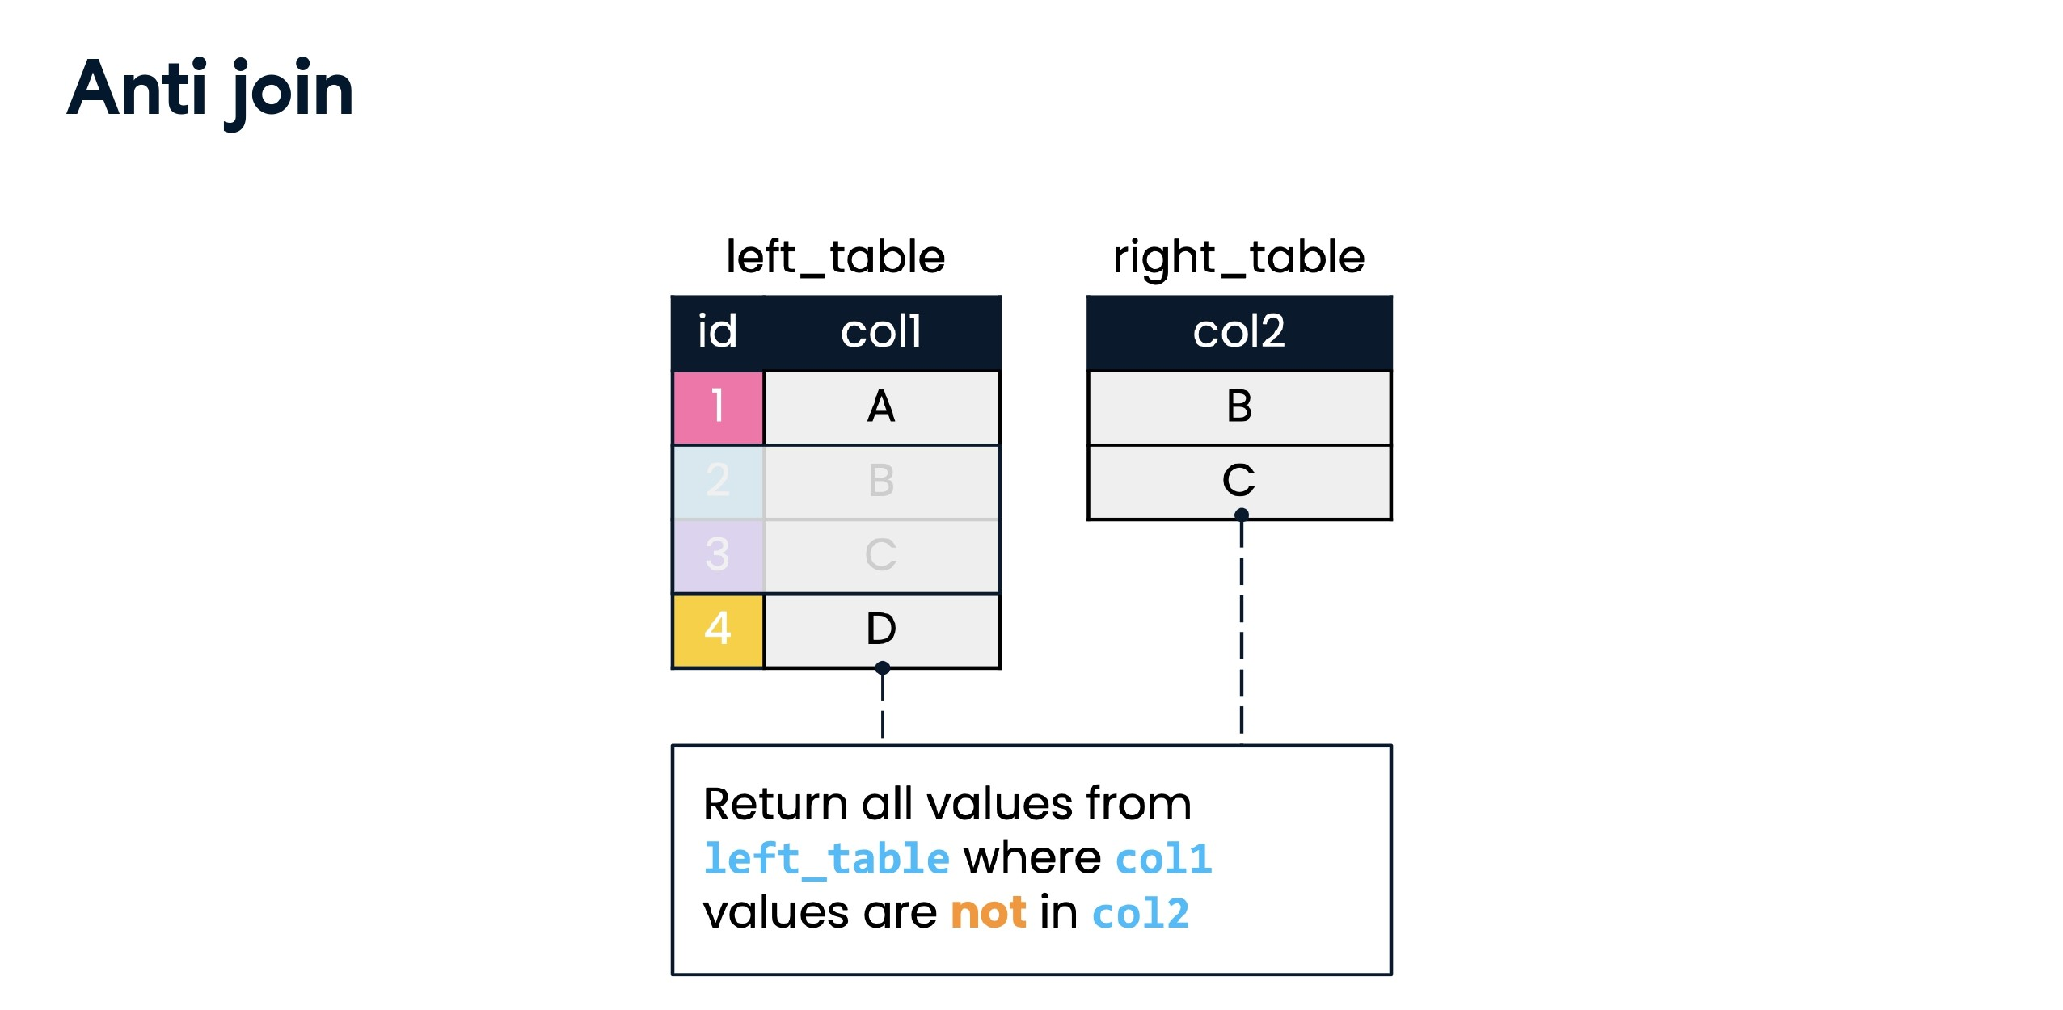

Slide 53
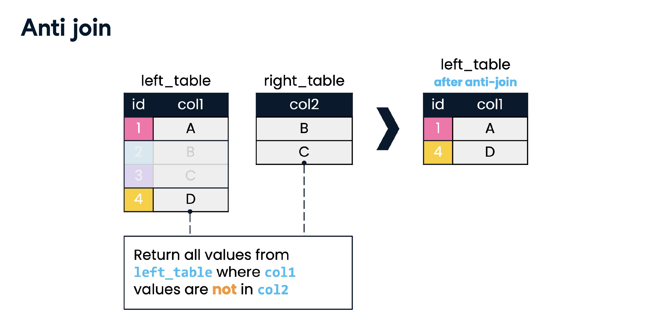

Slide 54
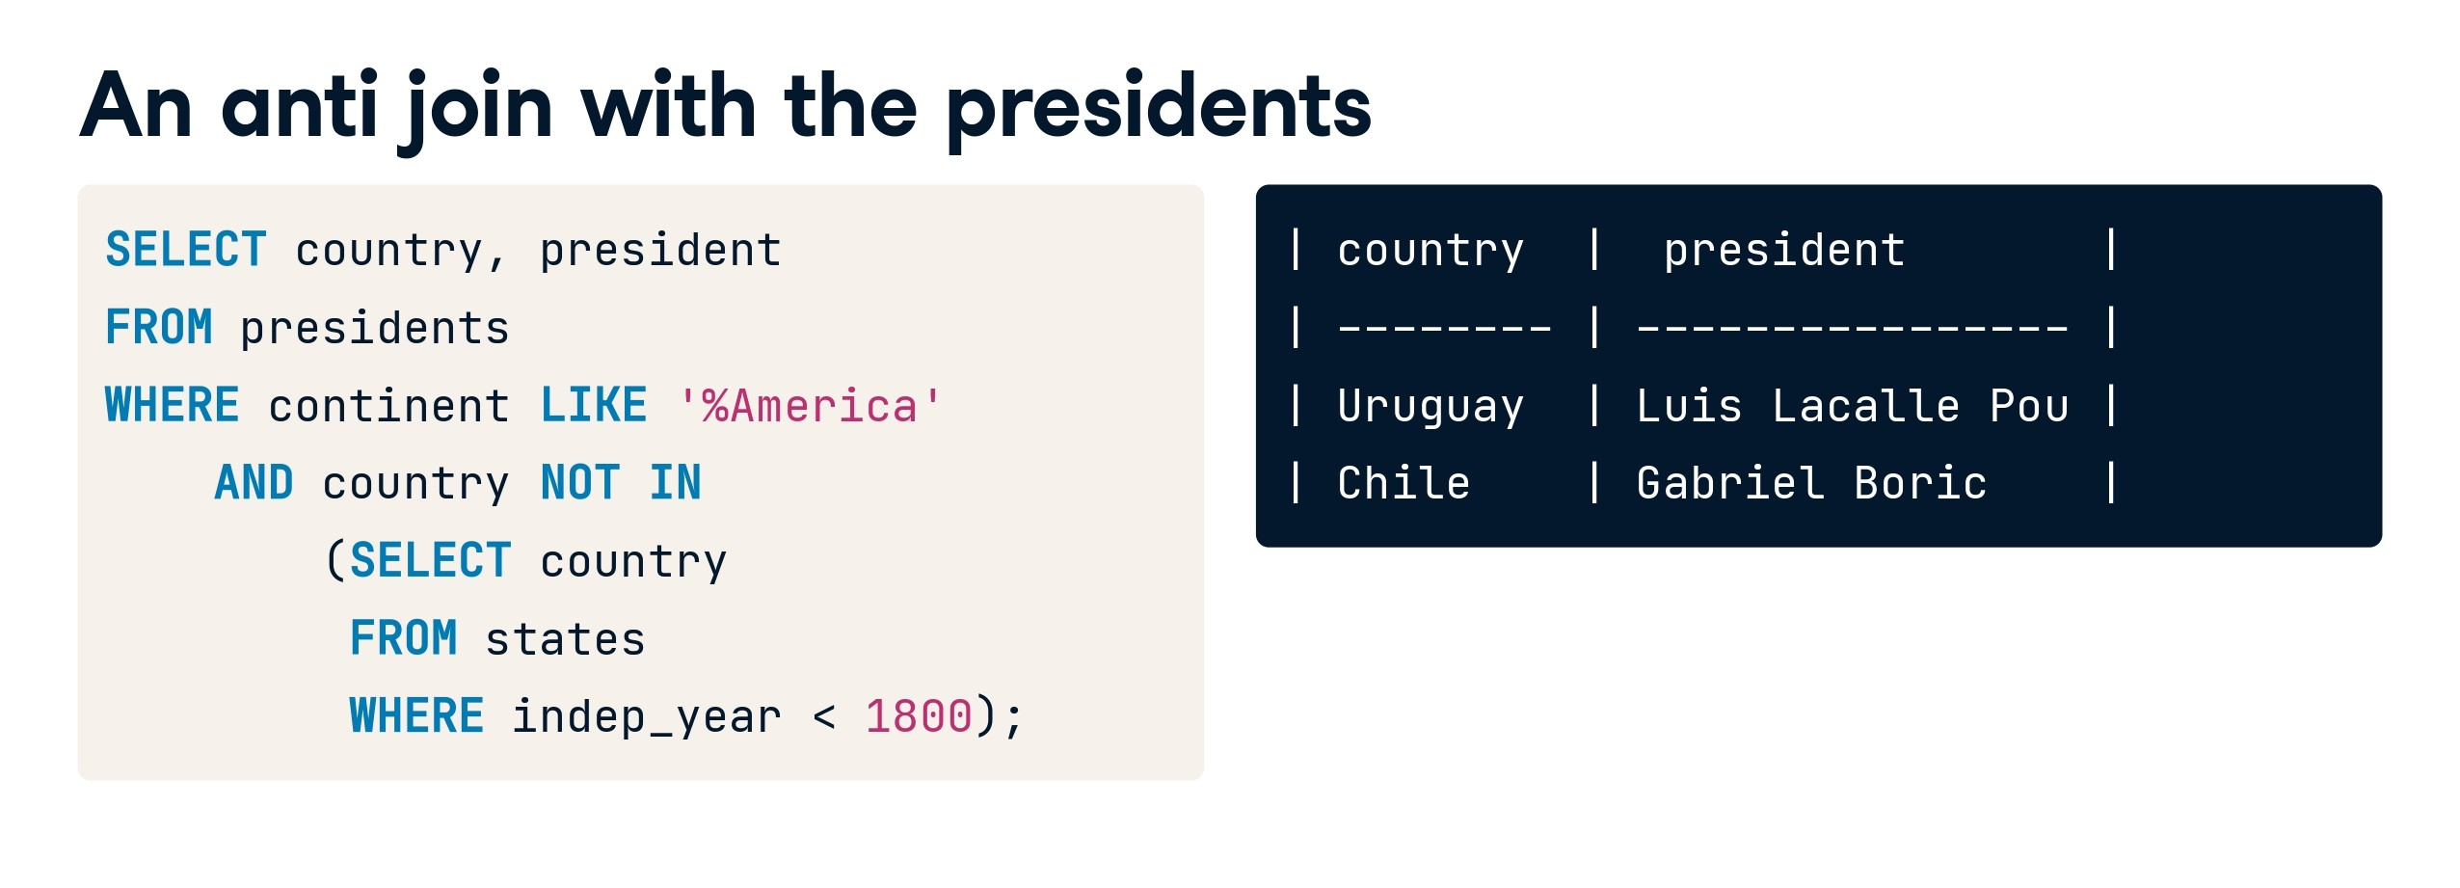

Slide 55


Slide 56
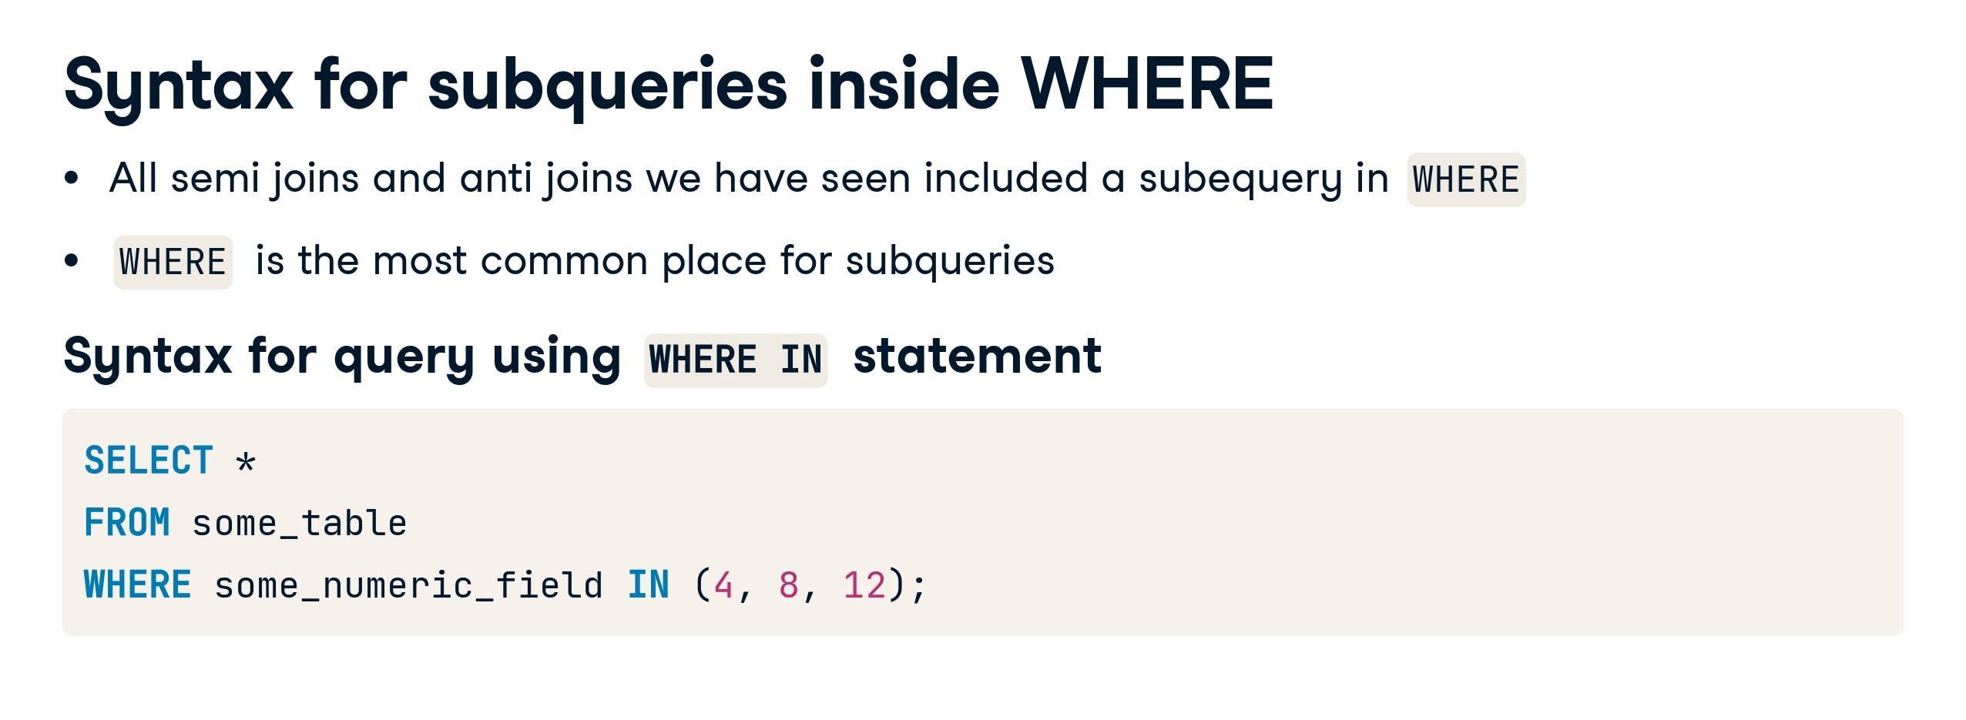

Slide 57
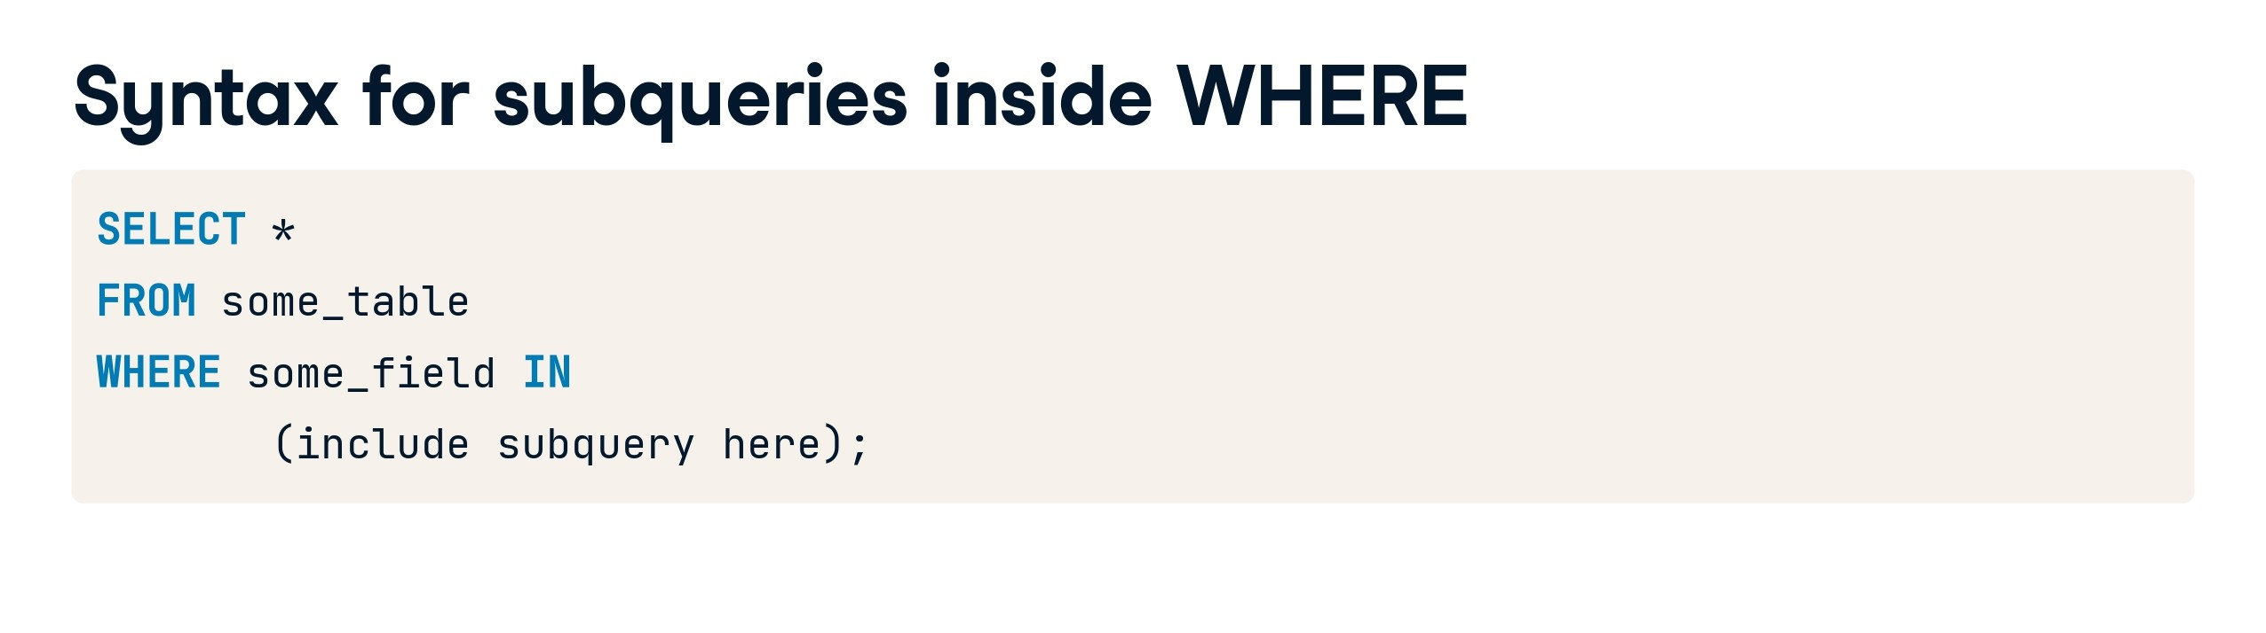

Slide 58
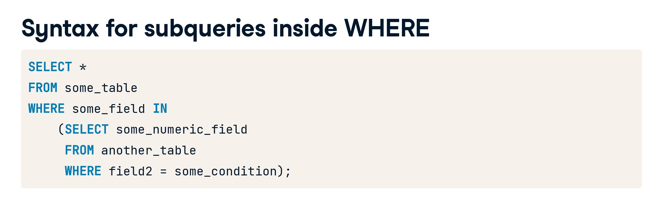

Slide 59


Slide 60


Slide 61


Slide 62


Slide 63


Slide 64


Slide 65


Slide 66


Slide 67


Slide 68


Slide 69


Slide 70


Slide 71
SELECT monarch AS leader, country
FROM monarchs
UNION
SELECT prime minister, country
FROM prime ministers
ORDER BY country, leader
LIMIT 10;

Slide 72
--UNION ALL with the leaders
SELECT monarch AS leader, country
FROM monarchs
UNION ALL
SELECT prime minister, country
FROM prime ministers
ORDER BY Leader, country
LIMIT 10;

Slide 73
--Countries with prime ministers and presidents
SELECT country as intersect_country
FROM prime ministers
INTERSECT
SELECT country
FROM presidents;

Slide 74
--INTERSECT on two fields
SELECT country, prime minister AS Leader
FROM prime ministers
INTERSECT
SELECT country, president
FROM presidents;

Slide 75
--Countries with prime ministers and monarchs
SELECT country, prime minister AS Leader
FROM prime ministers
INTERSECT
SELECT country, monarch
FROM monarchs;

Slide 76
--EXCEPT syntax
SELECT monarch, country
FROM monarchs
EXCEPT
SELECT prime_minister, country
FROM prime ministers;

Slide 77
--Finish the semi join (an intro to subqueries)
SELECT president, country, continent
FROM presidents
WHERE country IN
(SELECT country
FROM states
WHERE indep_year < 1800);

Slide 78
--An anti join with the presidents
SELECT country, president
FROM presidents
WHERE continent LIKE '%America'
AND country NOT IN
(SELECT country
FROM states
WHERE indep_year<1800);

Slide 79
--Subqueries inside SELECT
SELECT DISTINCT continent,
(SELECT COUNT(*)
FROM monarchs
WHERE states.continent = monarchs.continent) AS monarch_count
FROM states;

Slide 80
--Subqueries inside FROM
SELECT continent, MAX(indep_year) AS most_recent
FROM states
GROUP BY continent;

Slide 81
-- Create employees table
CREATE TABLE employees (
id INT PRIMARY KEY,
name VARCHAR(50),
job_title VARCHAR(50)
);
-- Insert data into employees table
INSERT INTO employees (id, name, job_title)
VALUES
(1, 'John', 'Engineer'),
(2, 'Alice', 'Manager'),
(3, 'Michael', 'Developer’),
(4, 'Michael', 'Developer’),
(5, 'Michael', 'Developer');
-- Create contractors table
CREATE TABLE contractors (
id INT PRIMARY KEY,
name VARCHAR(50),
job_title VARCHAR(50)
);
-- Insert data into contractors table
INSERT INTO contractors (id, name, job_title)
VALUES
(1, 'Sarah', 'Consultant'),
(2, 'Bob', 'Developer'),
(3, 'Emma', 'Analyst');

Slide 82
-- UNION
SELECT id, name, job_title
FROM employees
UNION
SELECT id, name, job_title
FROM contractors;

Slide 83
-- UNION
SELECT id
FROM employees
UNION
SELECT id
FROM contractors;

Slide 84
-- UNION
SELECT id, name, job_title
FROM employees
UNION all
SELECT id, name, job_title
FROM contractors;

Slide 85
-- UNION
SELECT id
FROM employees
UNION all
SELECT id
FROM contractors;

Slide 86
SELECT id
FROM employees4
intersect
SELECT id
FROM contractors;

Slide 87
SELECT id
FROM employees4
except
SELECT id
FROM contractors;

Slide 88
Case Study 3: Method 1
Find the second-highest id in the employees table:
SELECT MAX(id) as second_highest_id
FROM employees5
WHERE id < (SELECT MAX(id) FROM employees5);

Slide 89
Case Study 3: Method 2
Find the second-highest salary in the employees table:
select top 1 salary from
(
select top 2 salary from
Employees5
order by salary desc
)
result
order by salary

Slide 90
Case Study 3: Method 2
Find the fourth-highest salary in the employees table:
select top 1 salary from
(
select top 4 salary from
Employees5
order by salary desc
)
result
order by salary

Slide 91
Case Study 4:
Consider an example where we want to find all employees who have a job title that is present in a separate table:
SELECT id, name, job_title
FROM employees4
WHERE job_title NOT IN
(SELECT job_title FROM employees4 where job_title like 'Developer' );

Slide 92
Case Study 5:
A subquery to find employees with a salary greater than the average salary without having clause:
SELECT *
FROM employees
WHERE salary > (SELECT AVG(salary) FROM employees);

